Slide 1
Regulatory framework for aggregators in Republic of Croatia
- Workshop Establishing and Role of Regulator in the Electric Energy Market organized by USAID from American People
Davorin Brkić, mag. ing. el. techn. inf.,
Croatian Energy Regulatory Agency (HERA).
dbrkic@hera.hr
Neum, Bosnia and Herzegovina, 18 October 2022
Views expressed in this presentation are the personal views of the author, and are not binding for the company/institution the author works in, and do not necessarily coincide with official views of the company/institution

Slide 2
Covered topics
Regulatory framework for aggregators in Republic of Croatia (RC)
Applied aggregator model
Available market for participation of aggregators
Type of services provided by aggregators
Developmeng of independent aggregators market
Kinds of distributed resources participating in aggregation
Experiences with implementation, obstacles and guidelines for improving regulatory frameworks

Slide 3
Applicable legislative framework
In force - Regulation (EU) 2019/943 of the European Parliament and the Council of 5 June 2019 on the internal market for electricity
In force - Commission Regulation (EU) 2017/2195 of 23 November 2017 establishing a guideline on electricity balancing
In force - Commission Regulation (EU) 2017/1485 of August 02, 2017 establishing a guideline on electricity transmission system operation
In force - Regulation (EU) 2019/944 of the European Parliament and the Council of 5 June 2019 on common rules for the internal market for electricity and (...)
In development - Framework guidelines on demand response – „ACER will submit the framework guidelines to the European Commission by December 2022.” (https://www.acer.europa.eu/)
Repealed- Law on Electricity Energy Market (“Official Gazette” No. 22/13, 102/15, 68/18 and 52/19)
In force - Law on Electricity Energy Market (“Official Gazette” No. 111/21)
In force - Electricity System Balancing Rules (HOPS, 11/2019)
In the pocess of public discussions - Poposed Electricity System Balancing Rules
In force - Verification procedure for provision of auxilliary services aFRR and mFRR (HOPS, 2018)
In force - Rules of Changing Supplier and Aggegator (“Official Gazette” No. 84/22)
Current form - Contract on Provision of Balancing Service - mFRR
Current form - Contract on Provision of Balancing Service - aFRR
In force -Rulebook on General Conditions for Use of Network and Electricity Supply (“Official Gazette” No. 100/22)
In force - Methodology for Determining Price of Auxilliary Services (HOPS, 9/2020)
In force - Methodology for Determining Amounts of Tariff Items for ElectricityTransmission (“Official Gazette” No. 84/22)
In force - Rulebook on licences for carrying out energy activities and maintaining a registry of issued and withdrawn licenses for energy activity (“Official Gazette” No. 44/22)
In force - Rules for the Organization of the Electricity Market (“Official Gazette” No. 36/20)
In force - Rules for managing congestion in the Croatian electricity transmission system, including connecting lines (HOPS, 4/2021)

Slide 4
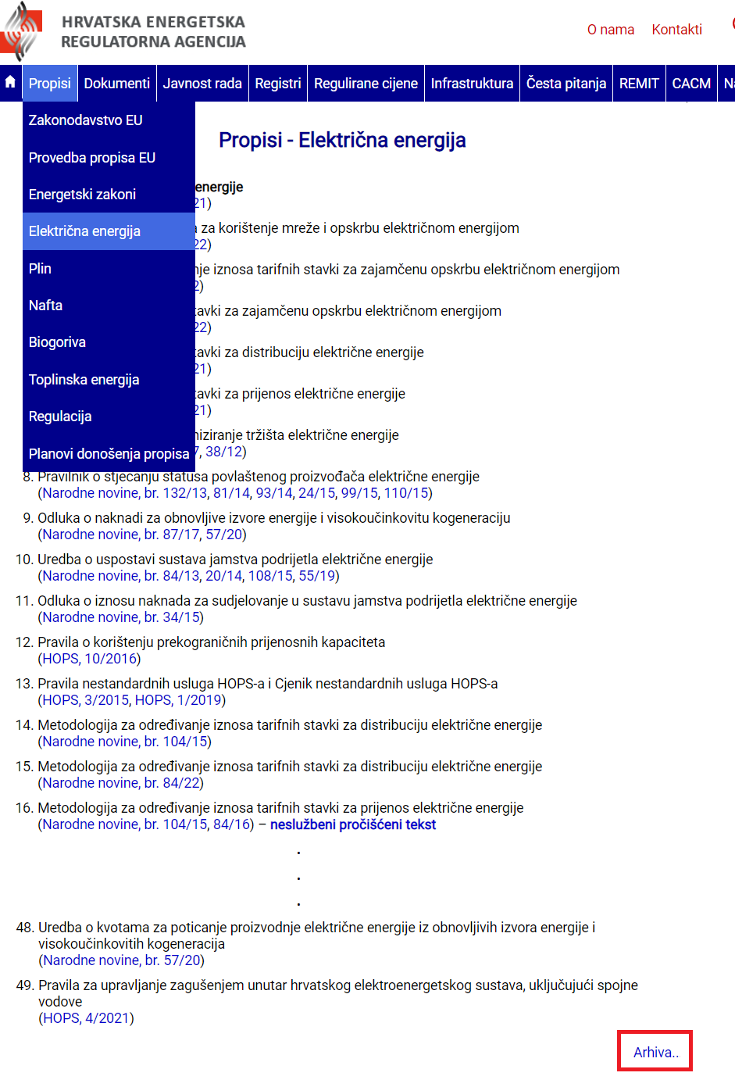
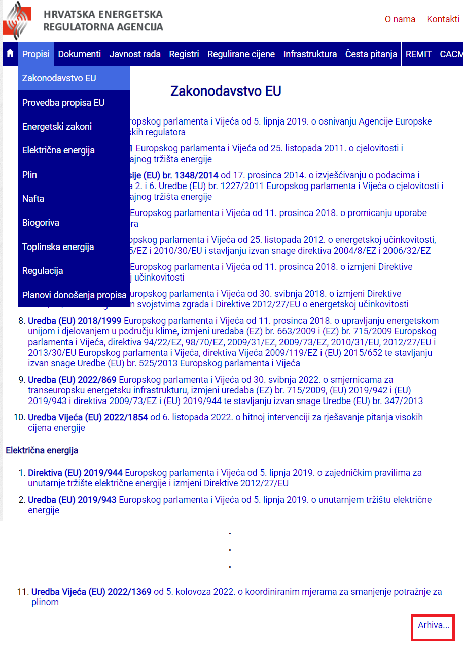
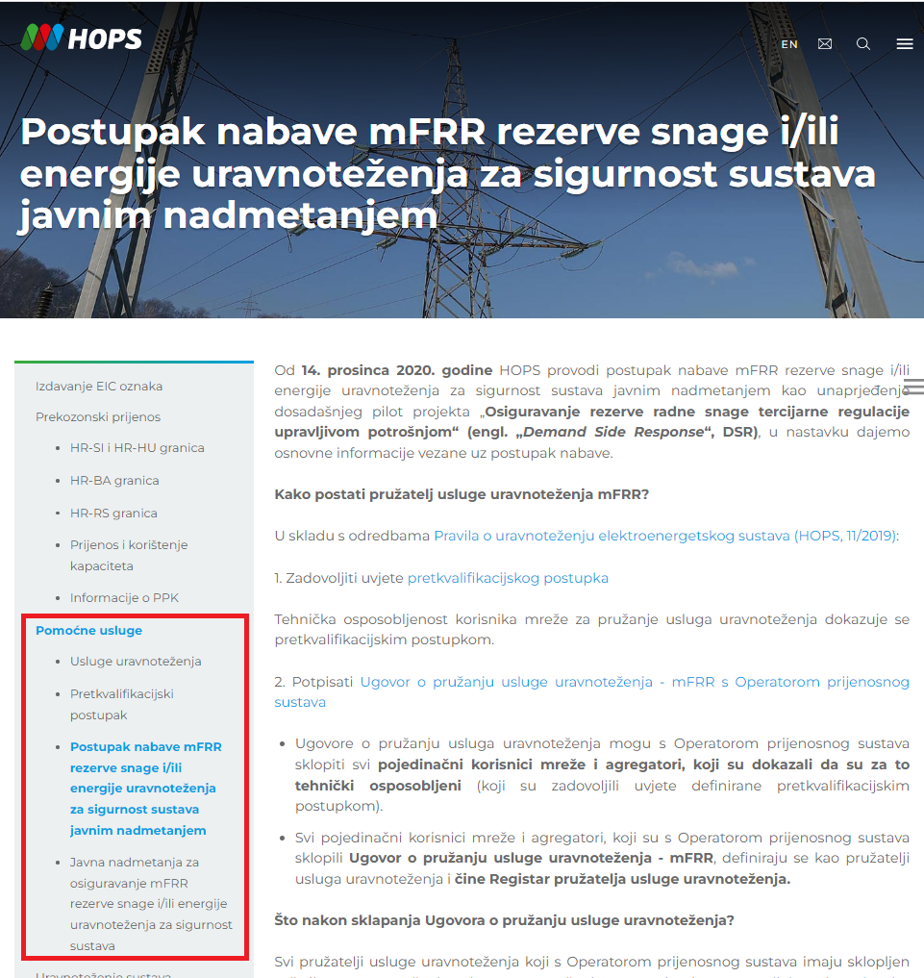
Where to find the documents
Valid and repealed (“Archive”) national
https://www.hera.hr/
Valid and repealed (“Archive”) EU legislation
https://www.hera.hr/
Pre-qualification procedure and contract formhttps://www.hops.hr/usluge-uravnotezenja
HOPS– Croatian Transmission System Operator ltd.

Slide 5
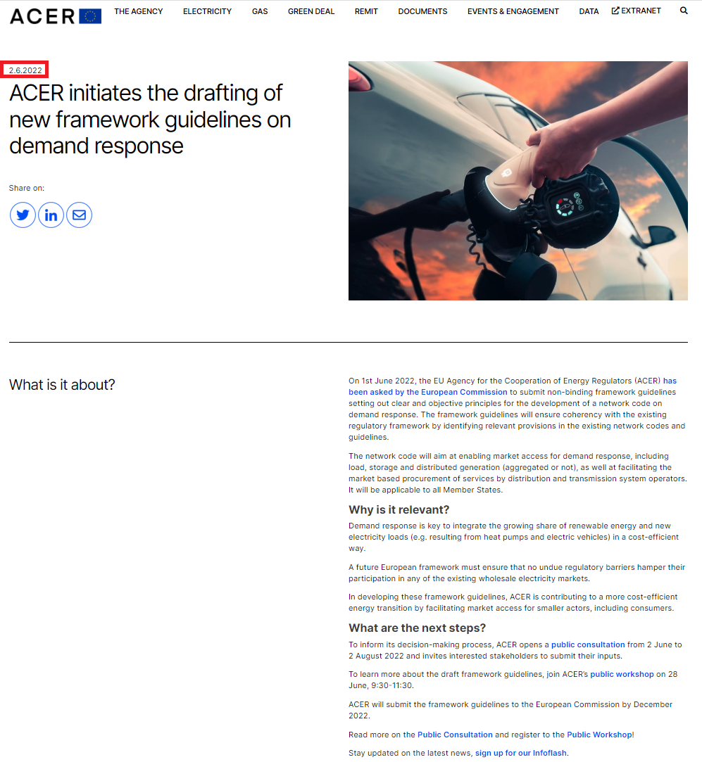
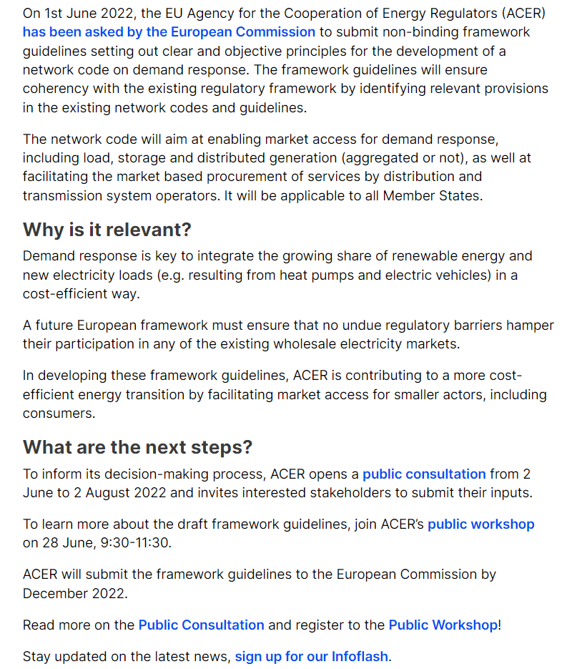
Framework guidelines on demand response
https://www.acer.europa.eu/events-and-engagement/news/acer-initiates-drafting-new-framework-guidelines-demand-response, pristup 13. 10. 2022.
ACER – Agency for Energy Regulators Cooperation

Slide 6
What is aggregation, who are aggregators and independent aggregator
Directive 2019/ 944 and Regulation 2019 / 943
  “Aggregation” is the function carried out by a physical or legal person by combining loads of a number of buyers or electricity generated for sale, purchase or auction at any electricity market.
Law on Electricity Energy Market (“Official Gazette” No. 111/21)
  “Aggregator” is a participant in the market who offers the services of aggregation.
Directive 2019/944
  “Independent aggregator” is a market participant who offers aggregation services and is not linked to the buyer’s supplier;

Slide 7
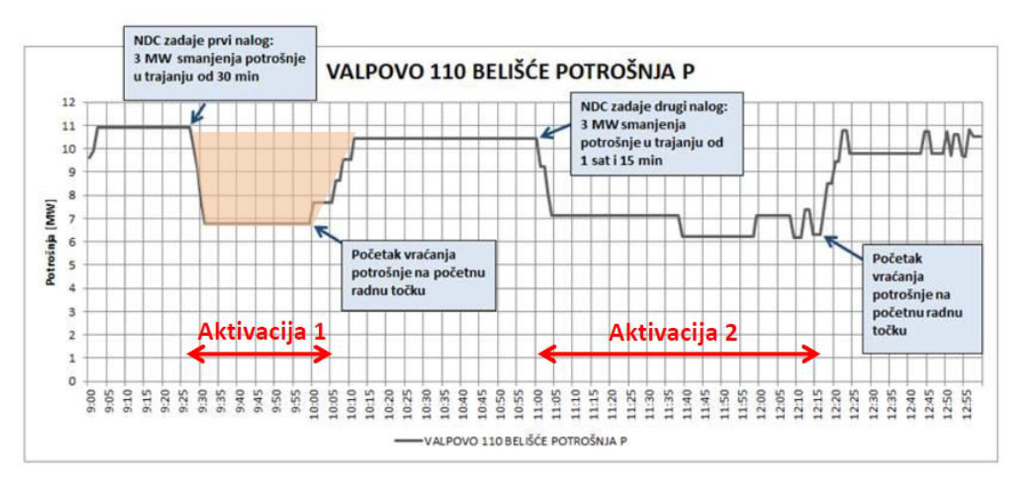
What is sometimes considered as „aggregator” and what is aggregator in general
Source for the figure above: Antun Andrić, Dalibor Sipl, Tonči Tadin, Josipa Jurjević, PILOT PROJEKT UPRAVLJANJA POTROŠNJOM – ISKUSTVA I DALJNJI RAZVOJ, HRO CIGRÉ, 2018., https://hro-cigre.hr/wp-content/uploads/2020/04/2-15-1.pdf
TSO – transmission system operator
DSO – distribution system operator

Slide 8
Target model for balancing of the European EES which would enable profit on cross-zonal exchange of balancing energy and FCR (flexibility)
EES – elektroenergetic system
Figure taken from https://hro-cigre.hr/wp-content/uploads/2022/07/Filozofija_09simpozij_zbornik.pdf and translated

Slide 9
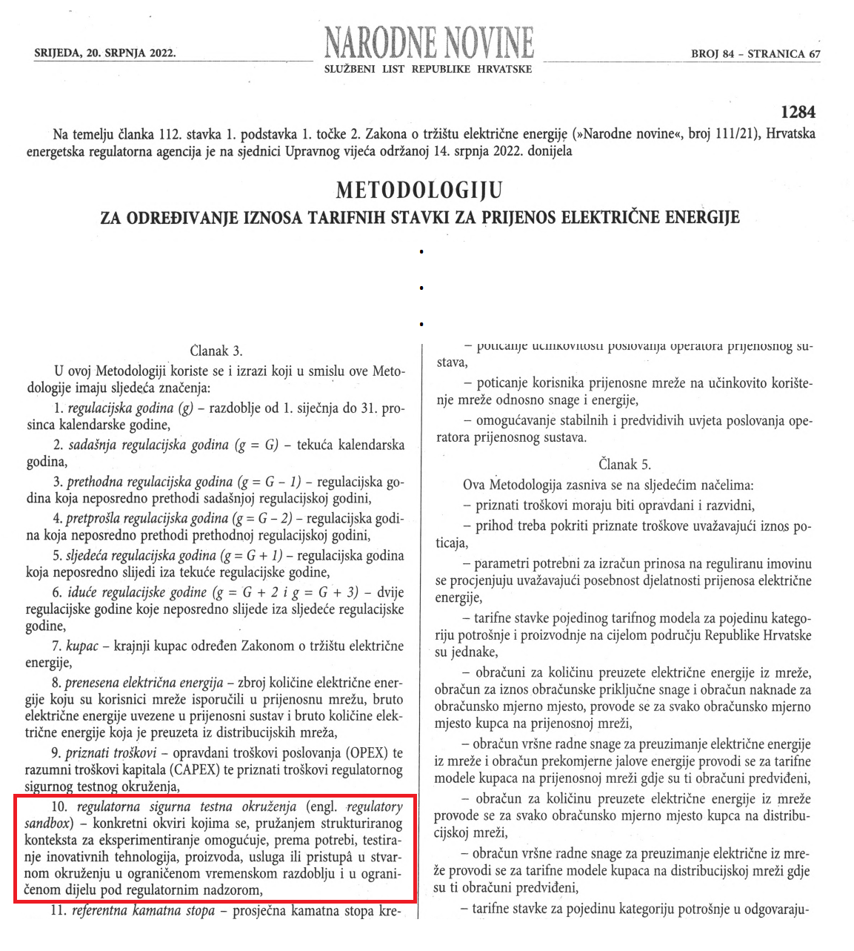
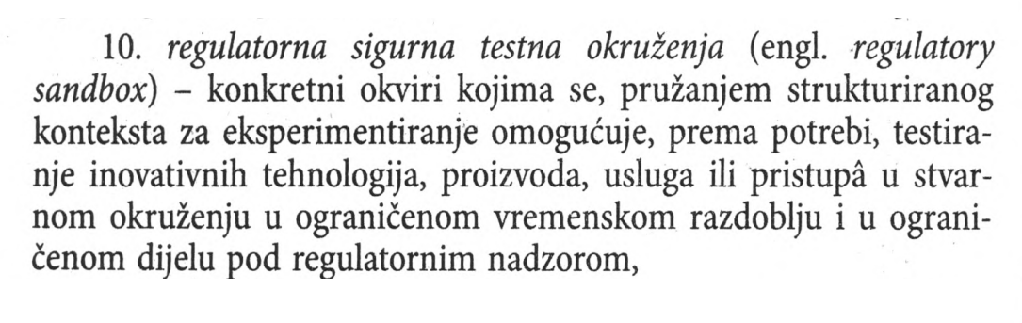
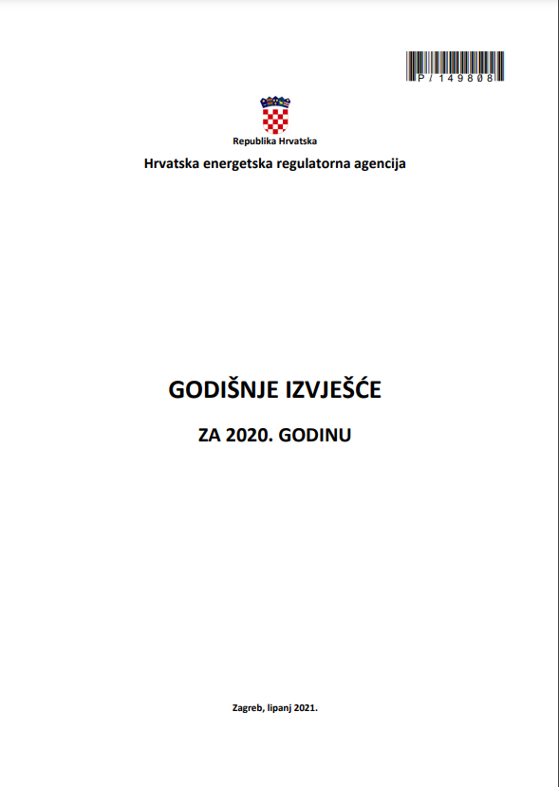
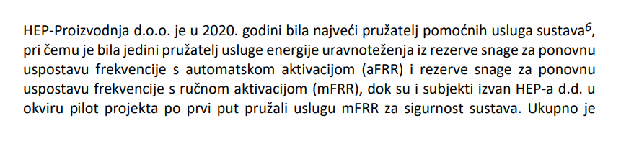
Market opening - subsidiarity, proportionality and regulatory safe testing environment (pilot project)
mFRR for security
monopoly => pilot project => open market
https://www.hera.hr/hr/docs/HERA_izvjesce_2020.pdf
https://hr.wikipedia.org/wiki/Supsidijarnost
https://eur-lex.europa.eu/HR/legal-content/glossary/proportionality-principle.html

Slide 10
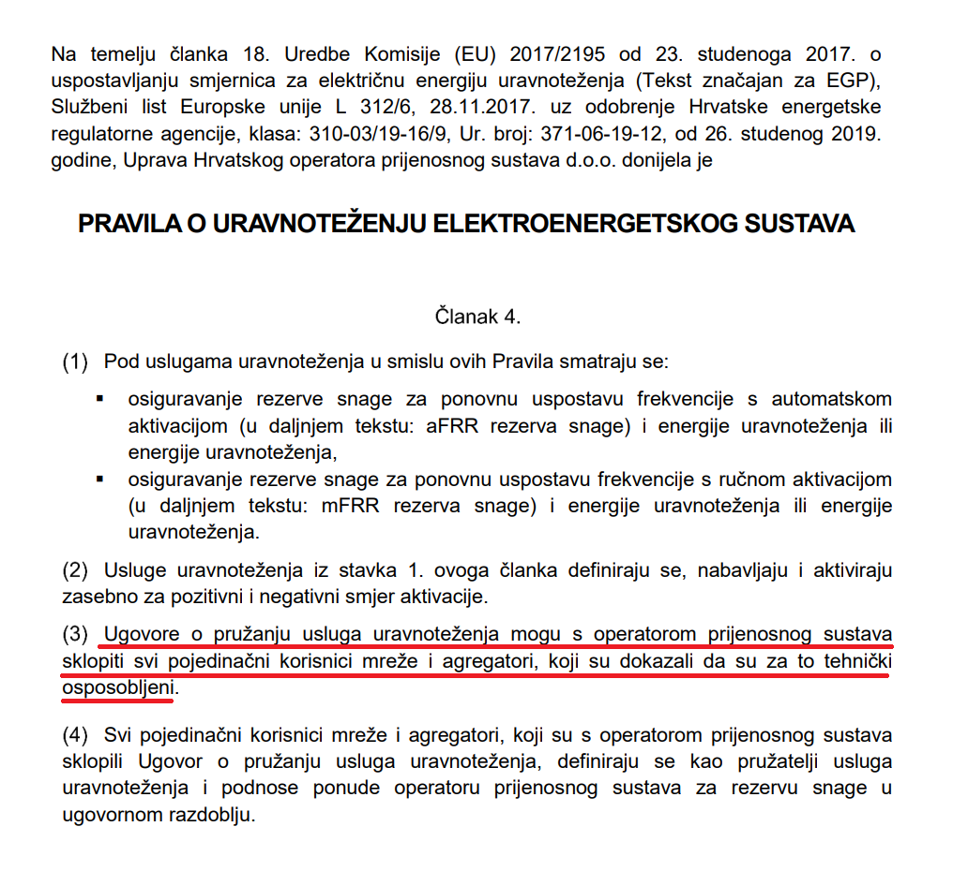
What legislation in force applies to aggregators (1/5)

Slide 11
What of the things the HOPS needs are offered by the aggregator in Republic of Croatia
I. Croatian transmission system operator ltd. (HOPS) procures the following services:
  1. Frequency containment reserve (FCR) (“primary power reserve”) - provided for free by HEP - Production ltd.
  2. Automatic frequency restoration reserve aFRR (“secondary power reserve”) - regulated price
  3. Manual frequency restoration reserve amRR (“tertiary power reserve”) - regulated price
  3a. mFRR for balancing - regulated price
  3b. mFRR for security – HEP-Production ltd., since 2020 other stakeholders, since January 2022 independent aggregator too
  4. Activation of reserves for FCR, aFRR, mFRR - price regulated, except for mFRR for security, which is market-based
  5. Compensation work for needs of regulation of voltage and reactive power - regulated price
  6. Starting production unit without external grid (“black start”) - regulated price
  7. Starting production unit without external grid - regulated price
  8. Availability of the production unit for island operation - regulated price
  9. Delivered electricity in island operation - regulated price
  10. Managing internal congestion by redispatching - regulated price, except when done through TSCNET
  II The HOPS procures all of mFRR for security in the market and through aggregators, prices of other reserves are procured from HEP-Production ltd at the prices calculated in accordance with the Methodology for Determining Prices for Provision of Auxiliary Services (HOPS, 9/2020)
TSCNET - Regional Security Coordinator (RSC) Service for the TSOs in Central and South Eastern Europe

Slide 12
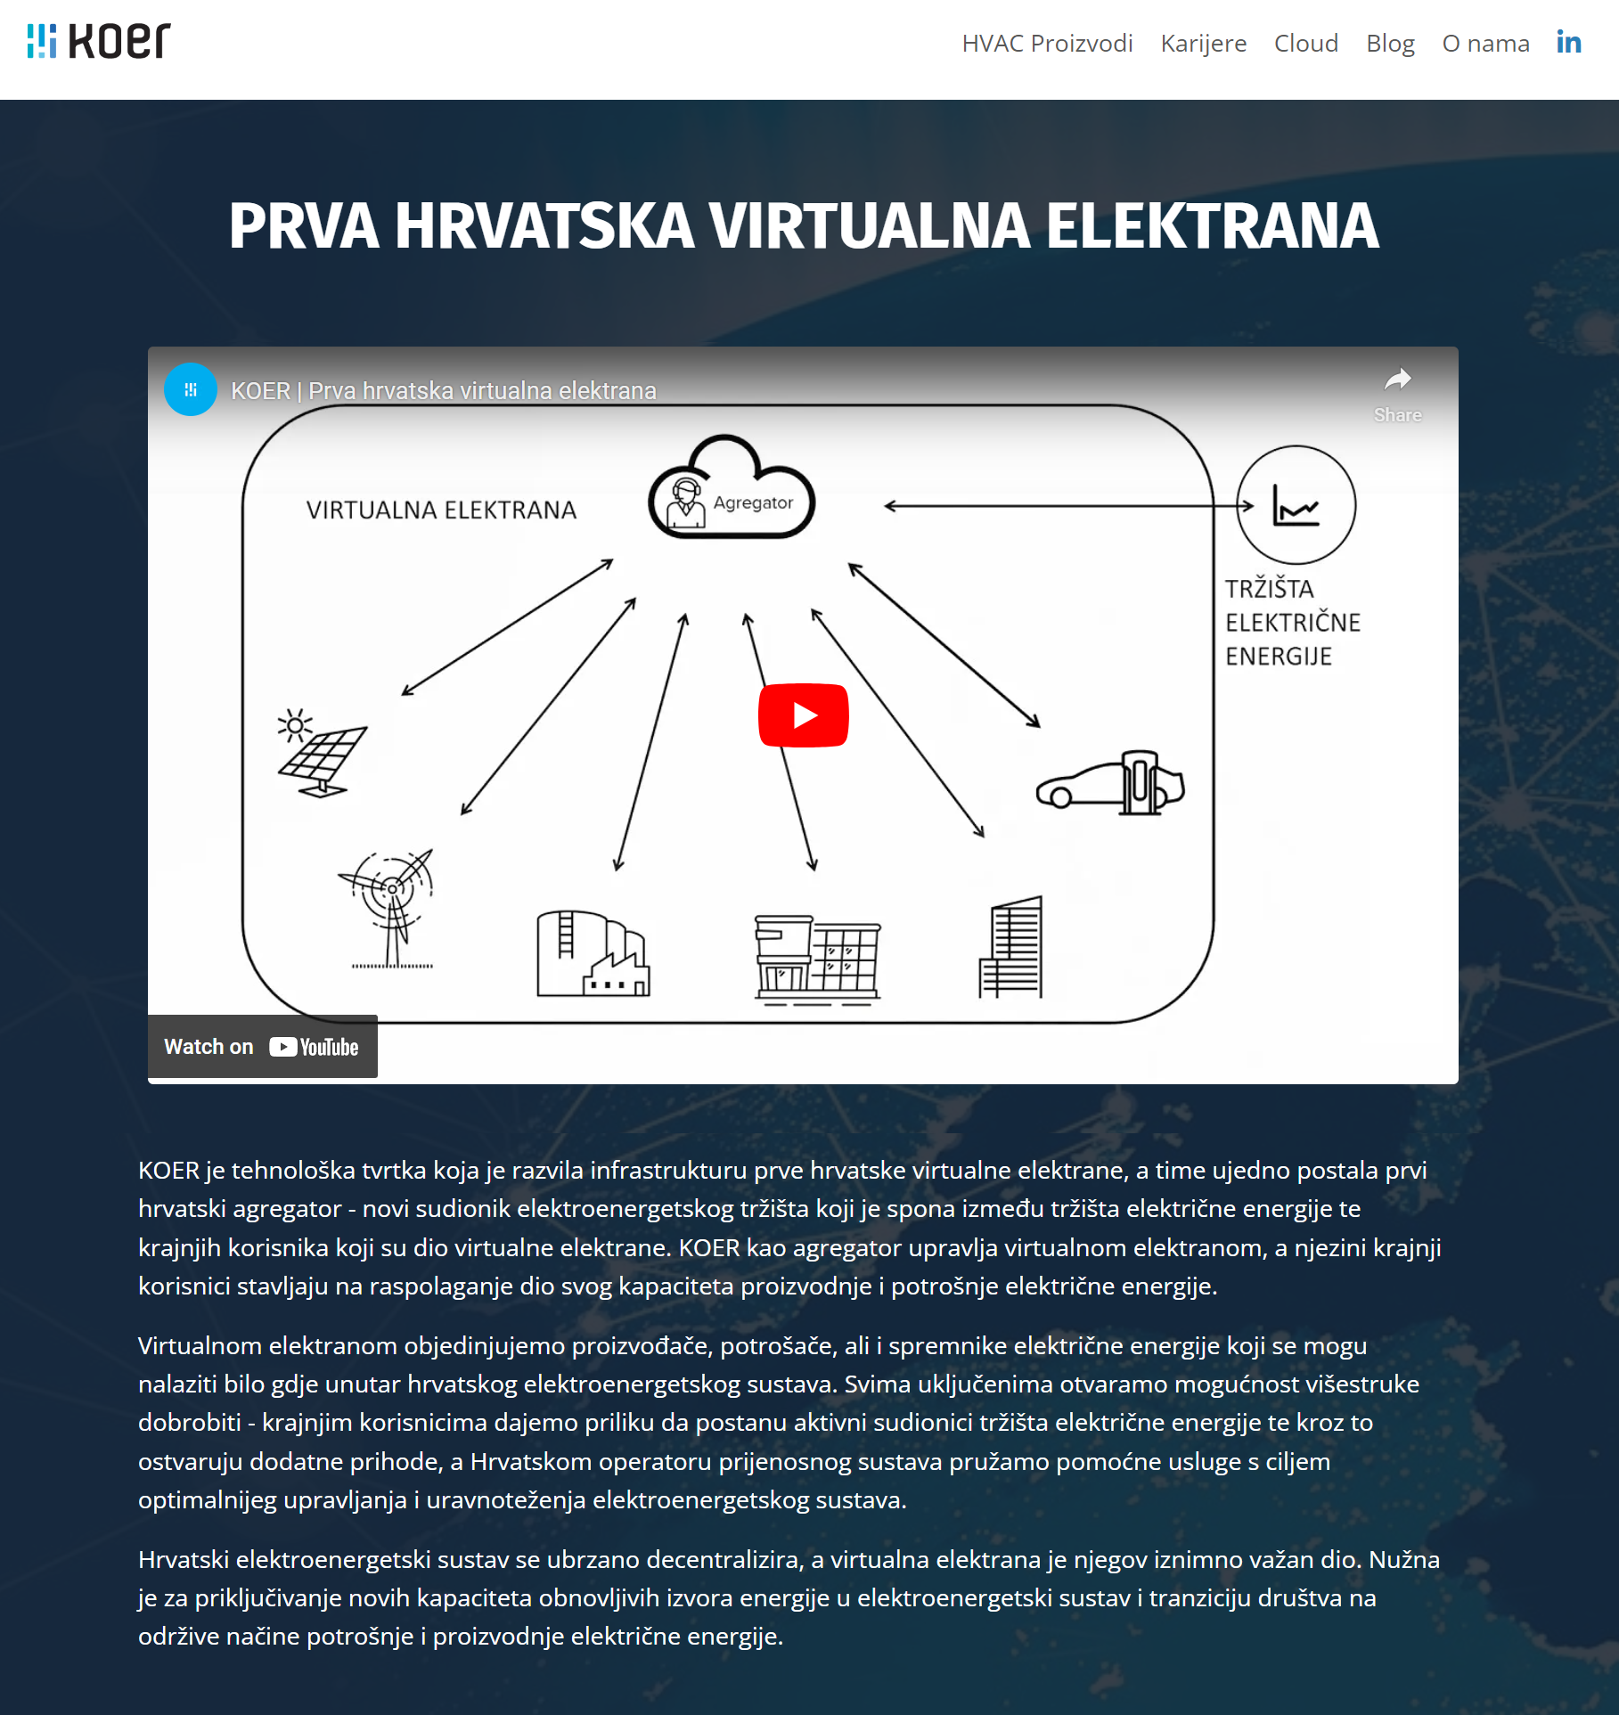
Independent aggregator KOER ltd. in Republic of Croatia
Downloaded from https://www.koer.com/, link to video https://www.youtube.com/watch?v=--vpyXZ1xJk

Slide 13
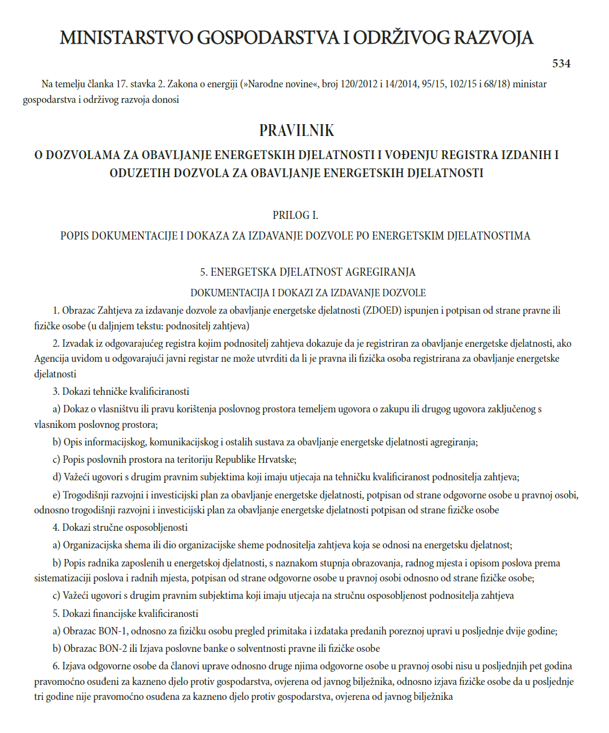
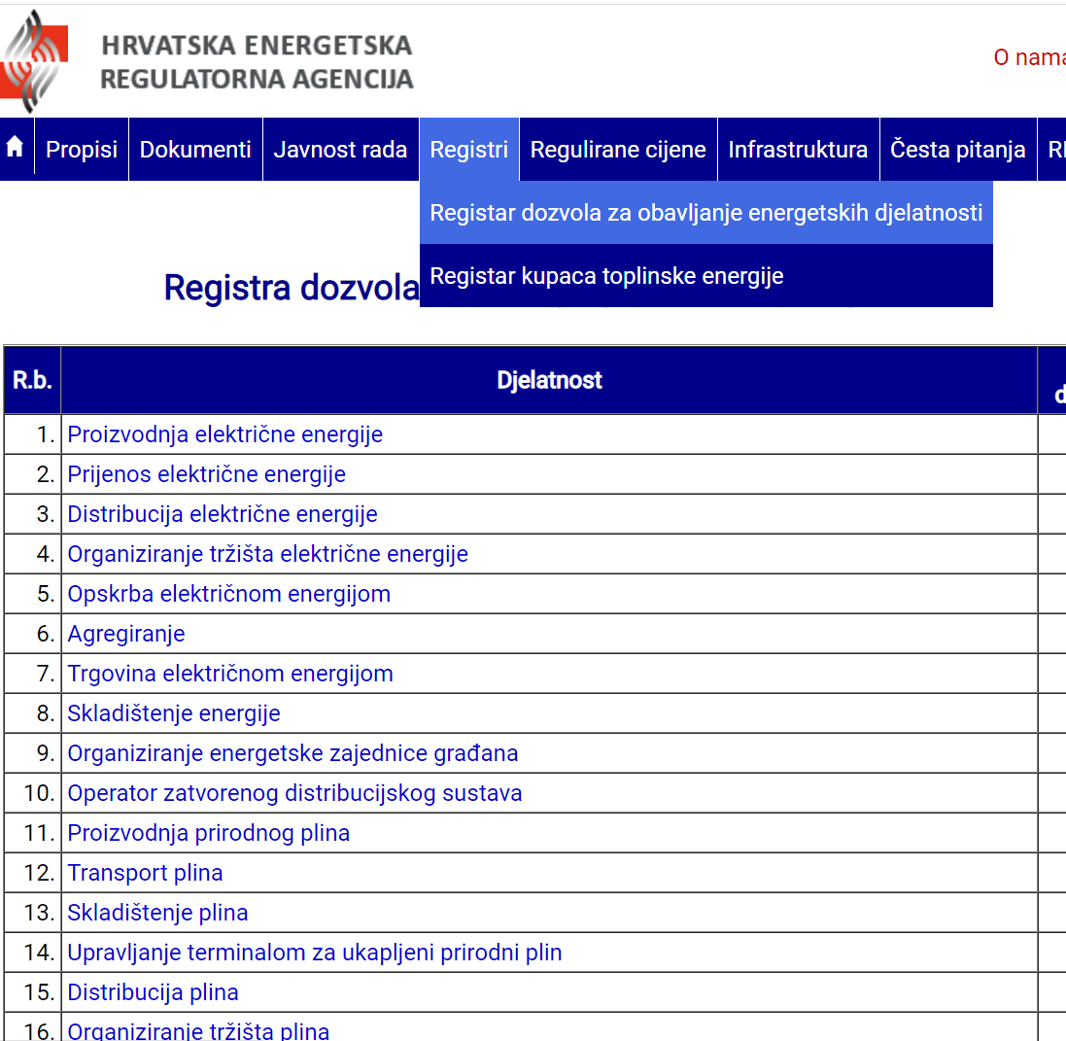
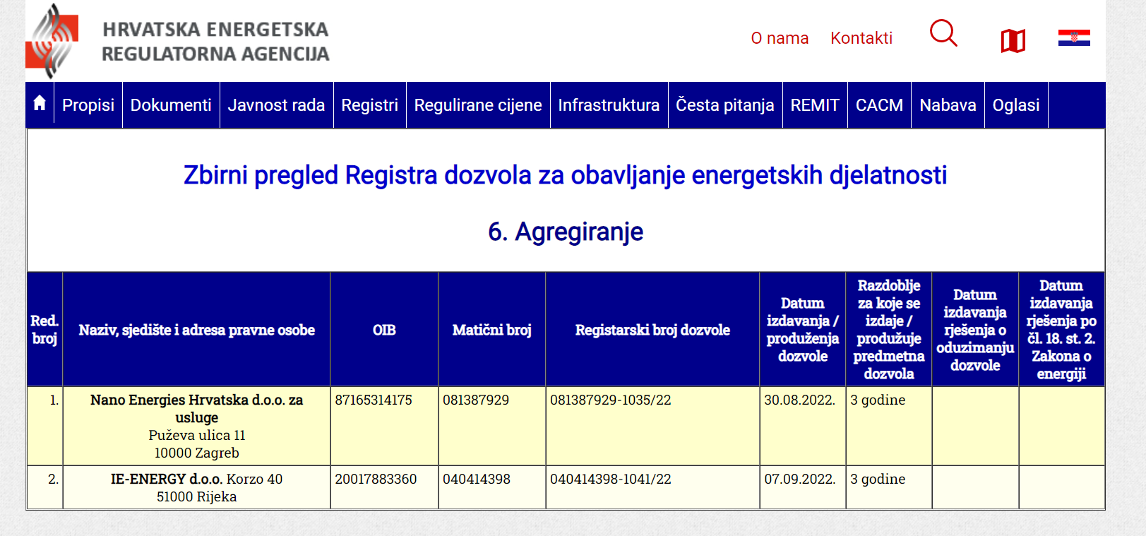
License for carrying out energy activity of aggregation

Slide 14
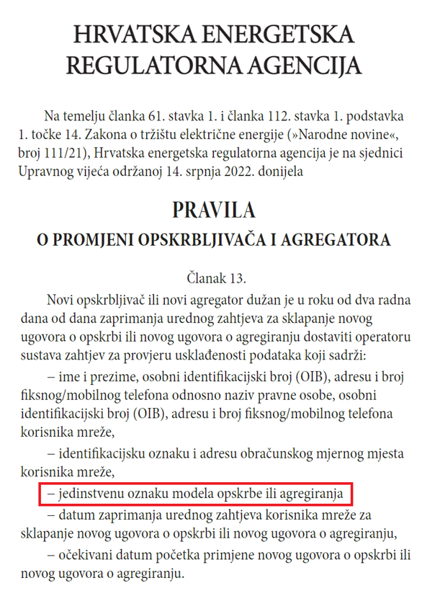
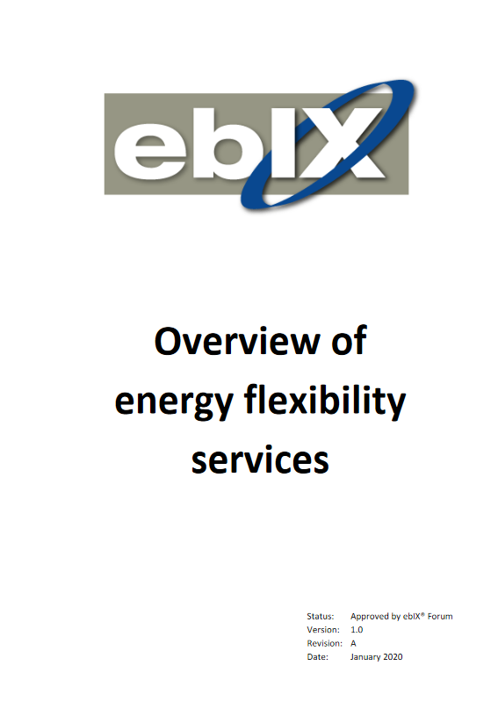
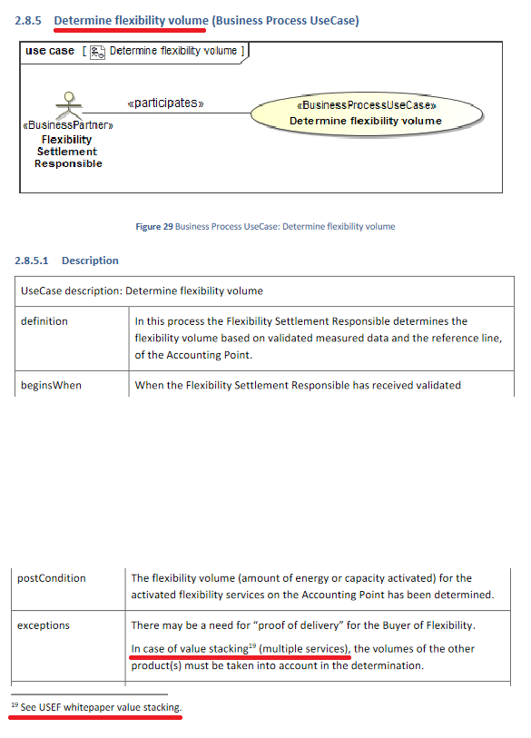
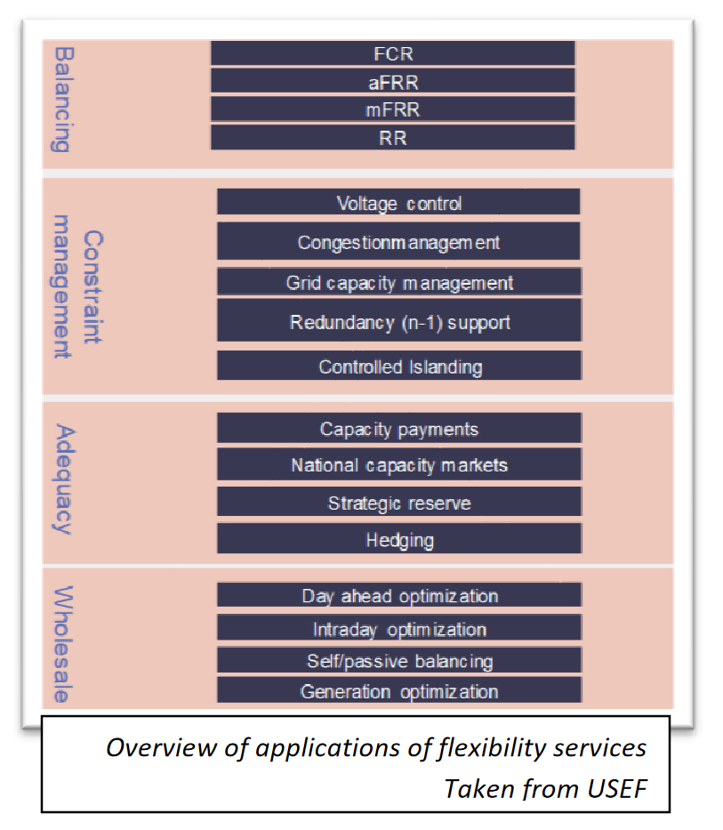
In which markets the aggregators may participate (1/2)
ebIX - European forum for energy business information exchange
USEF - Universal Smart Energy Framework
Accessible at: https://mwgstorage1.blob.core.windows.net/public/Ebix/ebIX%20Overview%20of%20energy%20flexibility%20services%20-%20v1r0A%2020200106.pdf

Slide 15

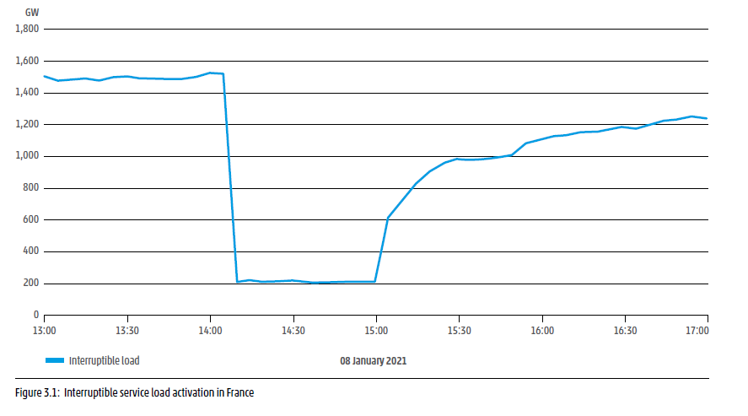
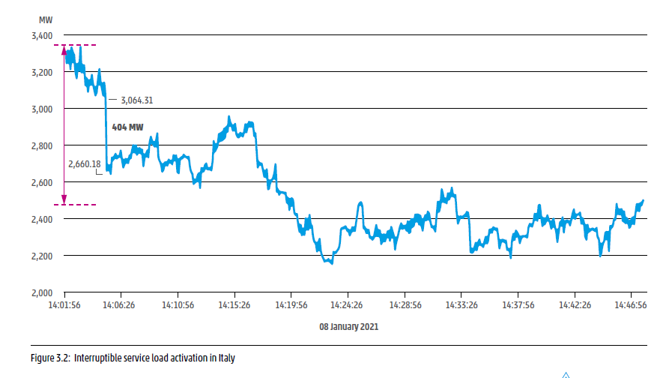
Consumer flexibility in France and Italy at the occasion of frequency disruption of 8 January 2021
Source: ENTSO-E (2021), Continental Europe Synchronous Area Separation on 08 January 2021 ICS Investigation Expert Panel » Final Report » 15 July 2021 Main Report, https://eepublicdownloads.azureedge.net/clean-documents/SOC%20documents/SOC%20Reports/entso-e_CESysSep_Final_Report_210715.pdf

Slide 16
In which markets the aggregators may participate (2/2) - France
„The NEBEF (“Notification d’Échange de Blocs d’Effacement”) was launched in 2014, creating a mechanism that allows curtailed load to bid as energy directly into the wholesale electricity market. During the first year, the volume amounted to a modest figure of 313 MWh. Between 2014 and 2015 volumes decreased further, and in 2015 the market generated only €1,783 for aggregators. The low wholesale market prices and requirements for payment of sourcing costs to the retailer are the main issues here.”
In France, in 2014, allowed was the work to an independent aggregator: „Since 2014, there is no need for consumers or aggregators to contract with a BRP in order to provide its flexibility to the markets (Balancing, NEBEF, Capacity mechanisms)”
„The capacity market for 2017 and beyond should also open new possibilities for Demand Response”
For the first time in history (notice of 3 March 2020), France has established a system for providing frequency containment reserve FCR (“primary power reserve”) in households by certifying company Voltalis to provide that service (10.729 buildings), which the stakeholder Voltalis may offer to Germany, Belgium, Austria, the Netherlands and Switzerland, https://www.rte-france.com/actualites/rte-et-voltalis-developpent-un-nouvel-outil-de-flexibilite-pour-la-gestion-du-reseau, pristup 14. 10. 2022.
„Demand-side flexibility can participate in the day-ahead and intraday market, balancing market and capacity market, as well as in TSO and DSO congestion management services”, izvješće iz 2022., https://publications.jrc.ec.europa.eu/repository/bitstream/JRC130070/JRC130070_01.pdf#page42
Source for the first three items: Bertoldi P, Zancanella P, Boza-Kiss B.; Demand Response Status in EU Member States; EUR 27998 EN;
doi:10.2790/962868, https://publications.jrc.ec.europa.eu/repository/bitstream/JRC101191/ldna27998enn.pdf

Slide 17
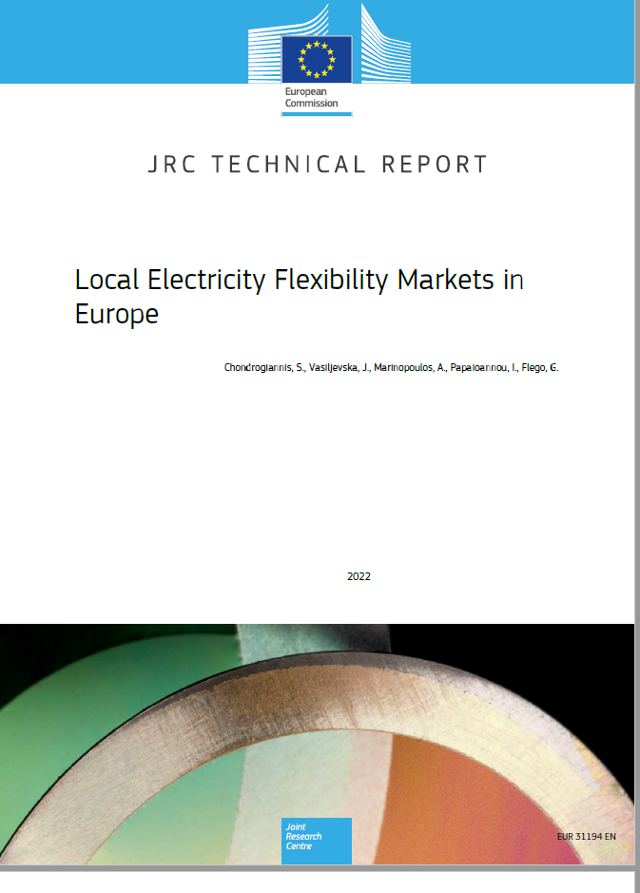
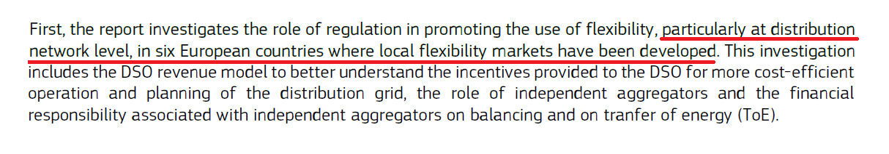
Flexibility markets in Europe - report from 2022
Accessible at: https://publications.jrc.ec.europa.eu/repository/bitstream/JRC130070/JRC130070_01.pdf
JRC - Joint Research Centre, the European Commission’s science and knowledge service.

Slide 18
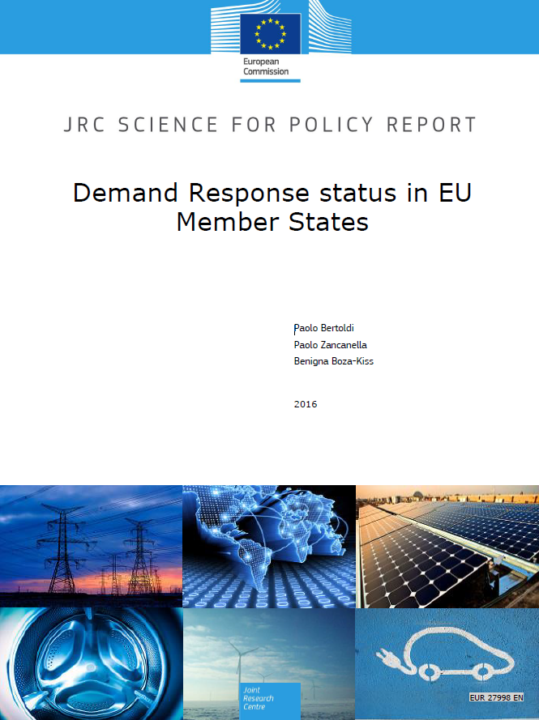
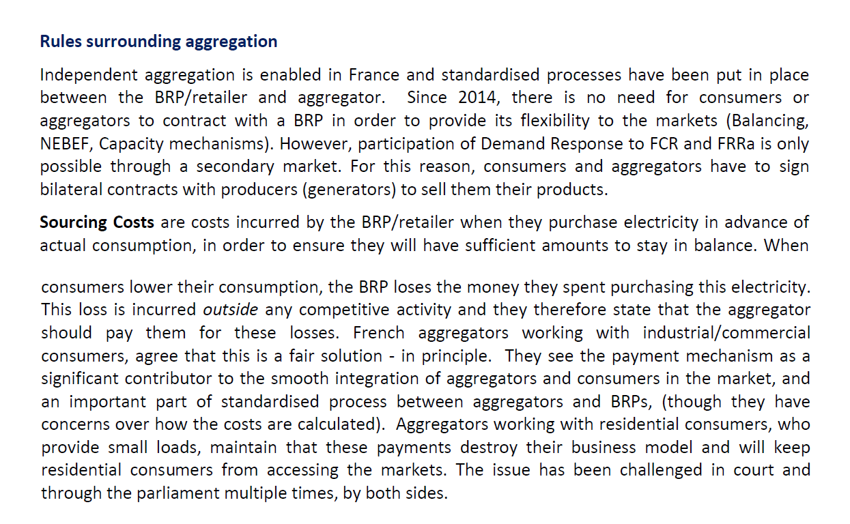
What is the core problem with independent aggregator - example from France
Report accessible at: https://publications.jrc.ec.europa.eu/repository/bitstream/JRC101191/ldna27998enn.pdf

Slide 19
What is it all about (1/4)
Purchases and sales of supplier without an explicit model with an independent aggregator
Wholesale market
+
Imbalance settlement
+
Reconciliation / second clearing
+
Retail market
=
0
Figure taken from Davorin Brkić, Holistički pristup i ilustracije za oslikavanje modela s HRO CIGRÉ-a iz 2015. koji sadrži ekonomske podsustave uravnoteženja, HRO CIGRÉ 2021., https://hro-cigre.hr/wp-content/uploads/2021/12/C5-02.pdf and translated

Slide 20
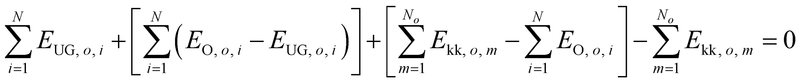
What is it all about, really (2/4) - one supplier and one independent aggregator
Equation of buy and sell balance for suppliers without explicit additional calculation regarding the independent aggregator
At request by the Transmission System Operator (TSO), and upon performance by aggregator influenced is the electricity exchange in the interval and on the interface with the network belonging to the supplier on
Reconciliation / second clearing
Obračun potrošačima / retail market
Veleprodajno tržište / wholesale market
Imbalance settlement / obračun odstupanja
Source: Davorin Brkić, Holistic approach and illustration for depicting a model with HRO CIGRÉ from 2015. that contains economic balancing sub-system, HRO CIGRÉ 2021. – conventions: (I) when the supplier buys in the first two calculation periods the net energy E>0, (ii) when the supplier sells to the consumer m E_{kk,o,m} >0
Equation of buy and sell balance for suppliers with explicit additional calculation regarding the independent aggregator
convention: when ΔE_{kor, o, i} >0 the aggregator has reduced consumption (reduced take from the network) and then the supplier sells to the TSO
Calculation of performance of regulation energy for differences (calculation between TSO and the supplier) / compensation for activated energy
The concept (2/4, 3/4, 4/4) is described in https://hro-cigre.hr/wp-content/uploads/2022/07/Filozofija_09simpozij_zbornik.pdf, most like to the “central settlement” model
From:
https://publications.jrc.ec.europa.eu/repository/bitstream/JRC130070/JRC130070_01.pdf

Slide 21
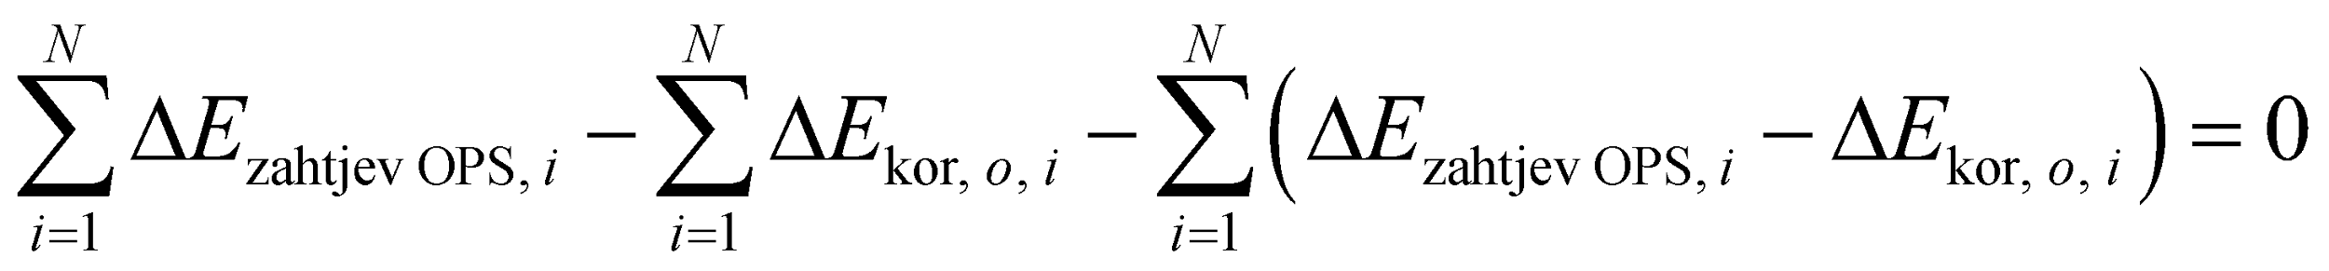
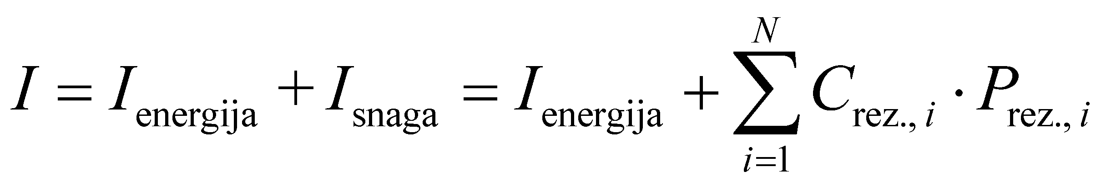
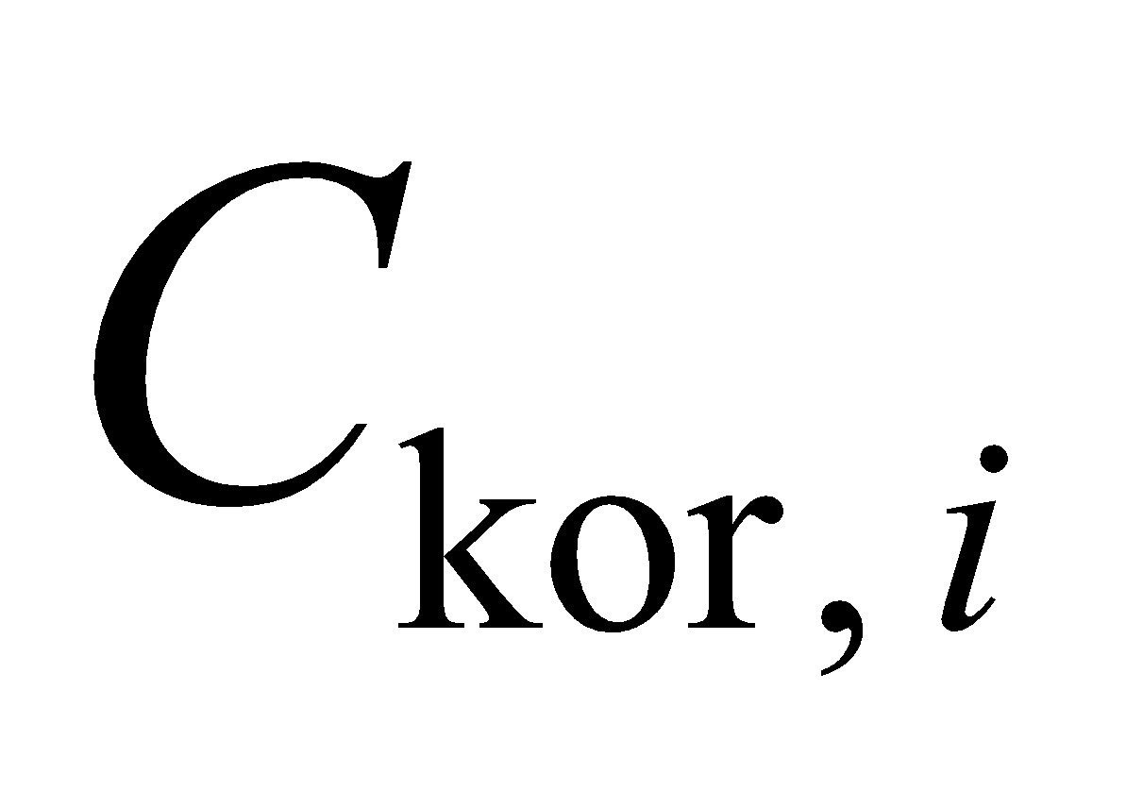
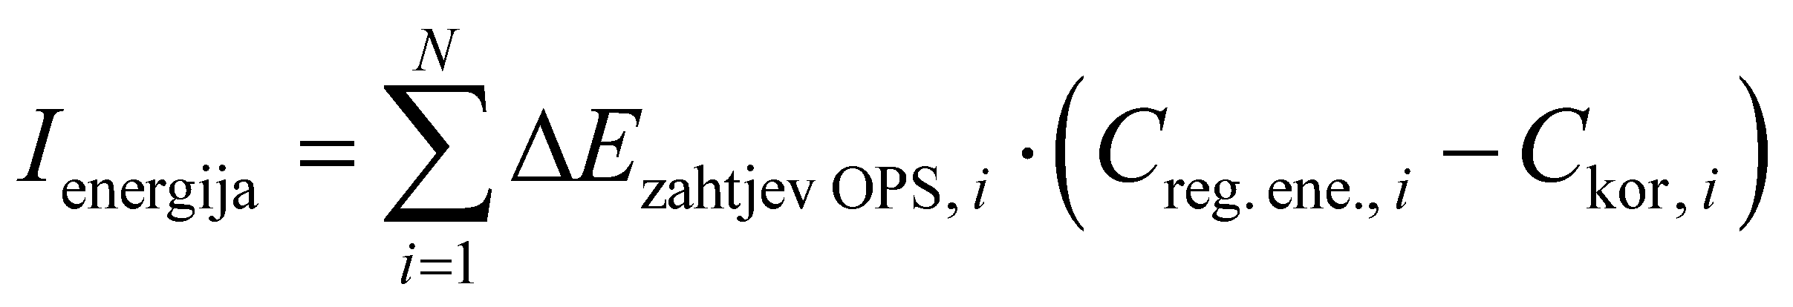
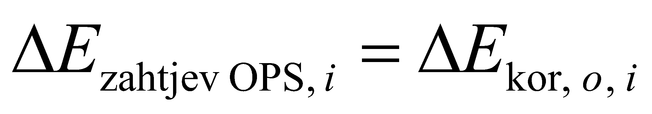
What is it all about, really (3/4) - one supplier and one independent aggregator
Equation for buy and sell balance for an independent aggregator
conventions: (i) when Request _{TSO}>0 TSO requests reduced consumption and aggregator sells the regulation energy to TSO, (ii) when ΔE_{kor, o, i} >0 the aggregator has reduced consumption and now the aggregator buys energy from TSO in the calculation of performance of reg. energy for differences
Calculation of regulation energy by quantity from TSO request / balancing energy settlement
Calculation of performance of regulation energy for differences (calculation between TSO and the independent aggregator) / compensation for activated energy
Obračun odstupanja / imbalance settlement
Obračun rezerve snage / balancing capacity settlement
Financial flows for the independent aggregator
- e.g. composition of prices with CROPEX for interval and
Monthly net revenue
If
, then is the net revenue from activations

Slide 22
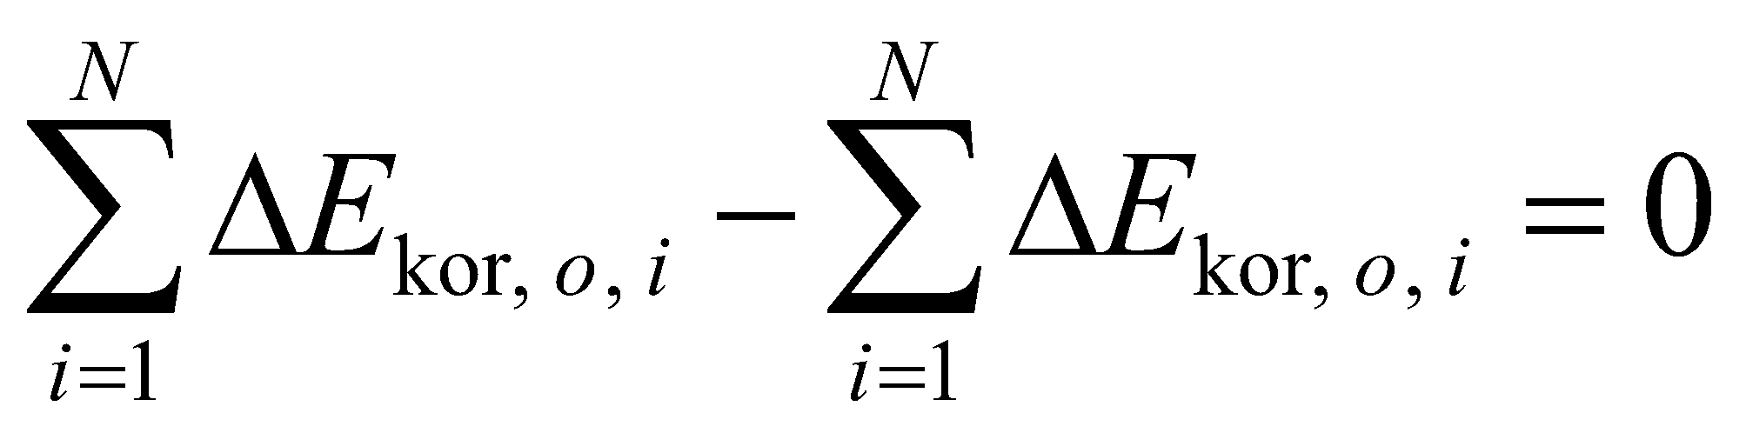
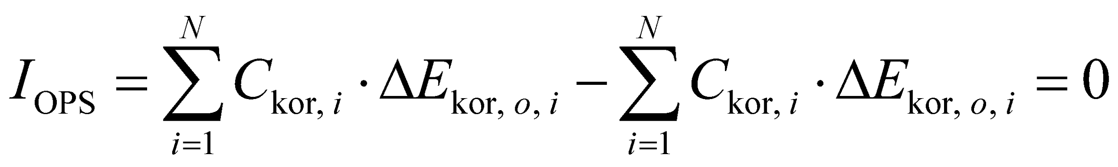
What is it all about, really (4/4) - one supplier and one independent aggregator
Partial equation for buy end sell balance for transmission system operator
convention. when ΔE_{kor, o, i} > 0 aggregator has reduced consumption and then the TSO sells energy to the aggregator in the settlement of performance of regulation energy, and buys in the same calculation the energy from the supplier
Calculation of performance of regulation energy for differences (calculation between TSO and the independent aggregator)
Calculation of performance of regulation energy for differences (calculation between TSO and the supplier)
Partial financial flows of the transmission system operator - calculation of performance of regulation energy for differences

Slide 23
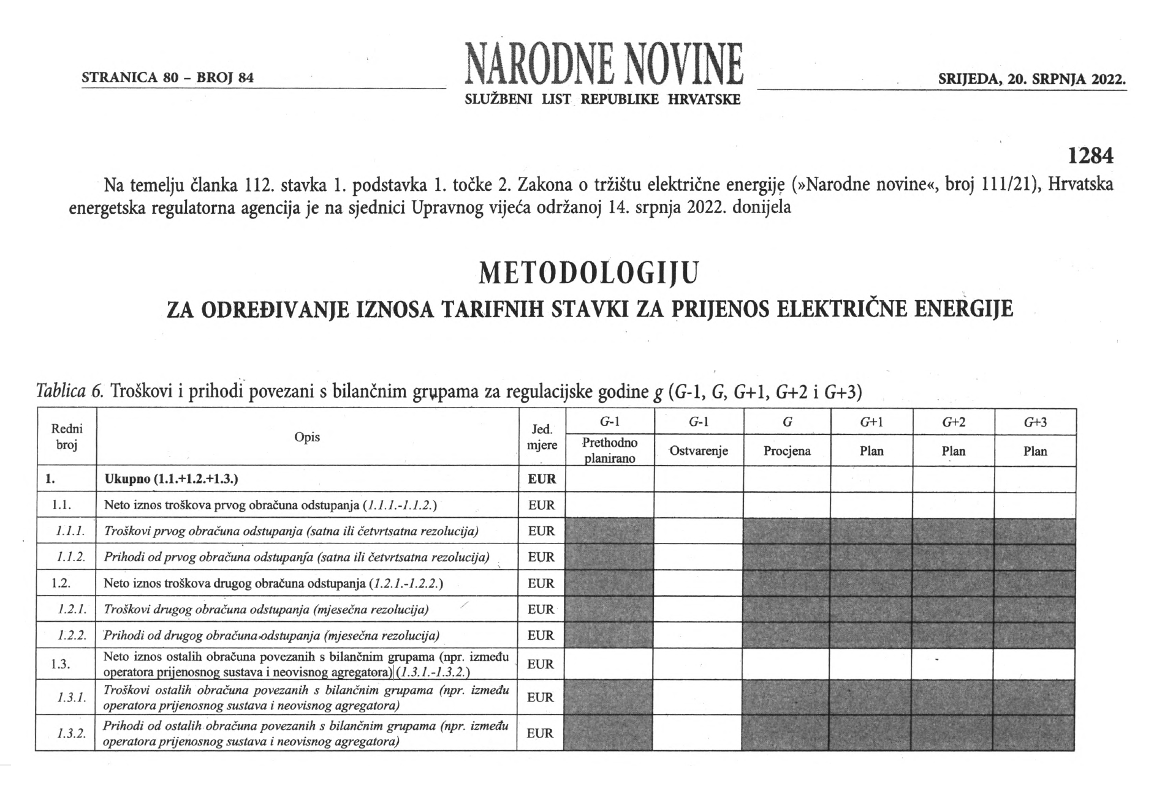
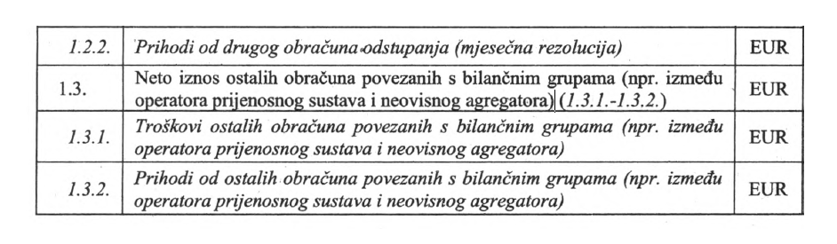
Expenditures and revenues of the HOPS from calculations related to balance groups, including independent aggregator

Slide 24
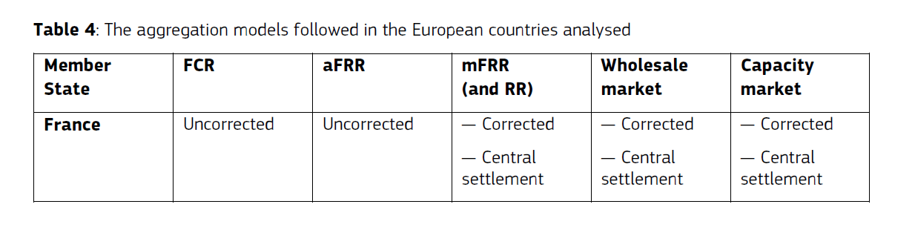
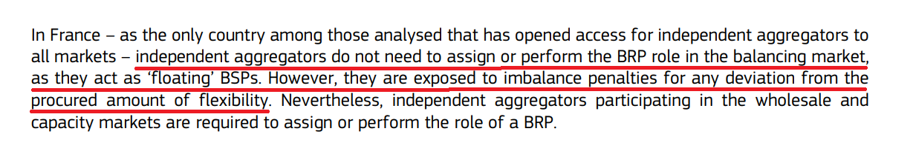
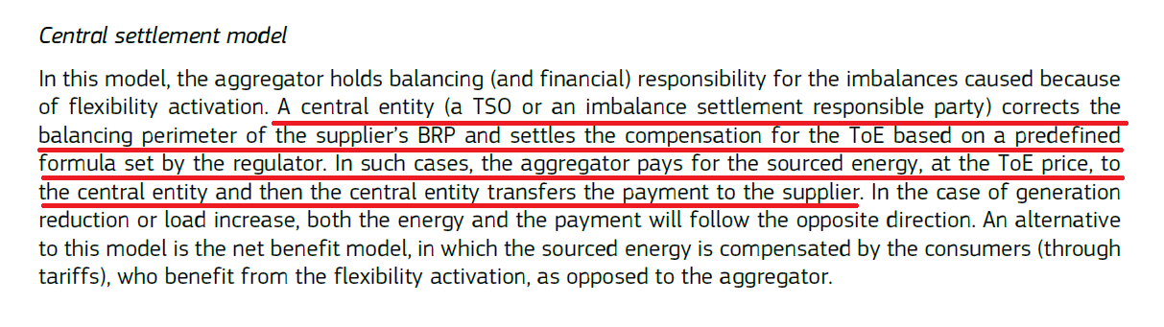
Flexibility markets in Europe - central settlement model and France
Accessible at: https://publications.jrc.ec.europa.eu/repository/bitstream/JRC130070/JRC130070_01.pdf

Slide 25
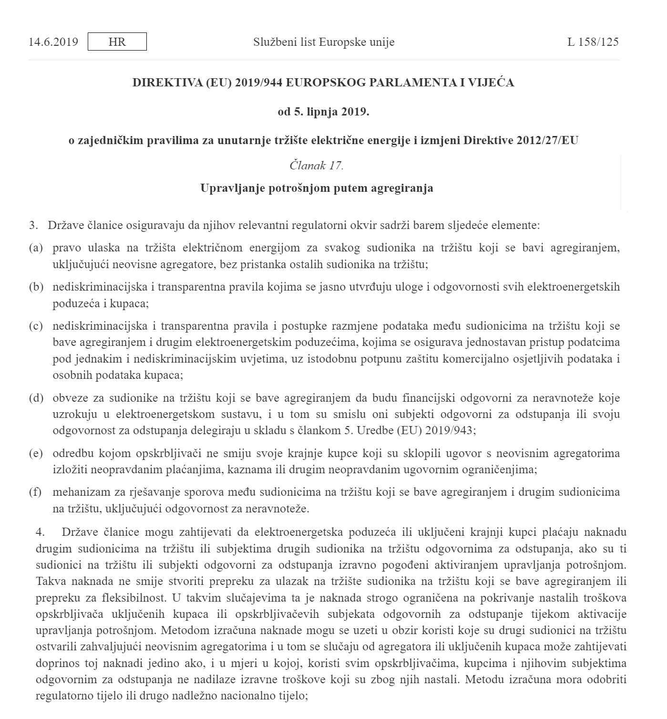
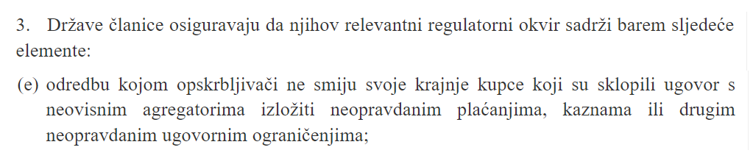
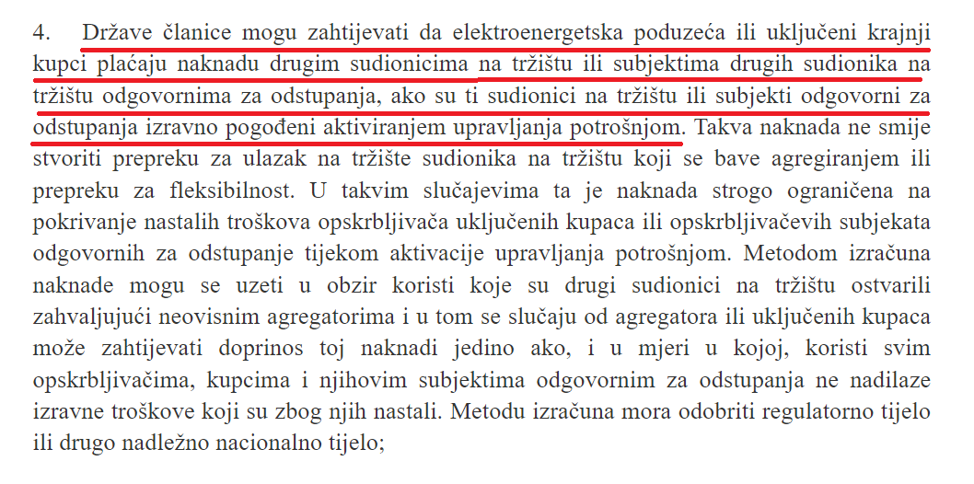
What has been prescribed for independent aggregator regarding compensation to supplier (1/4)

Slide 26
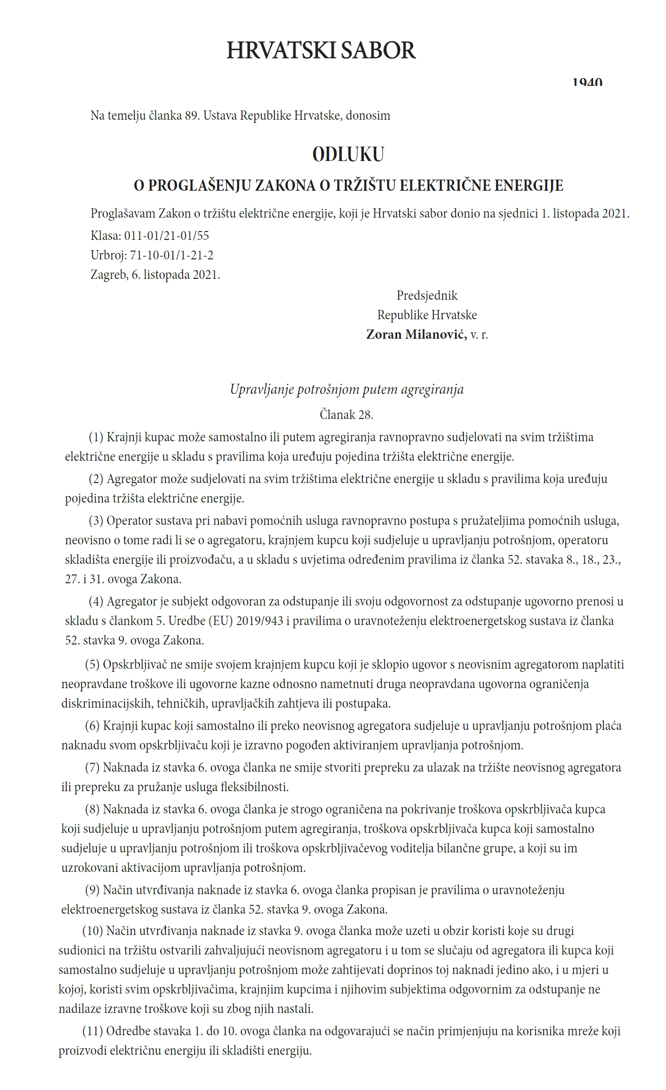
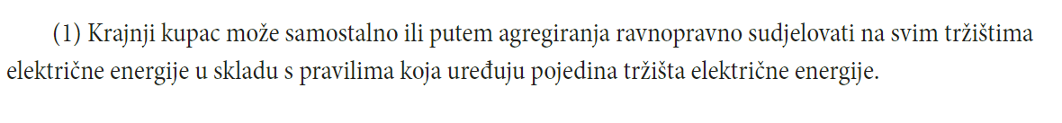
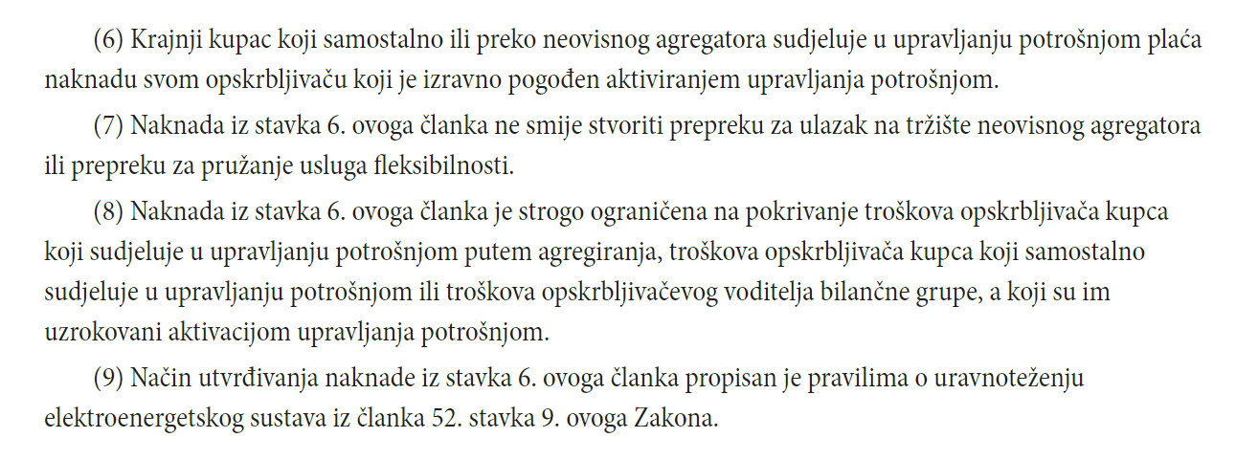
What has been prescribed for independent aggregator regarding compensation to supplier (2/4)

Slide 27
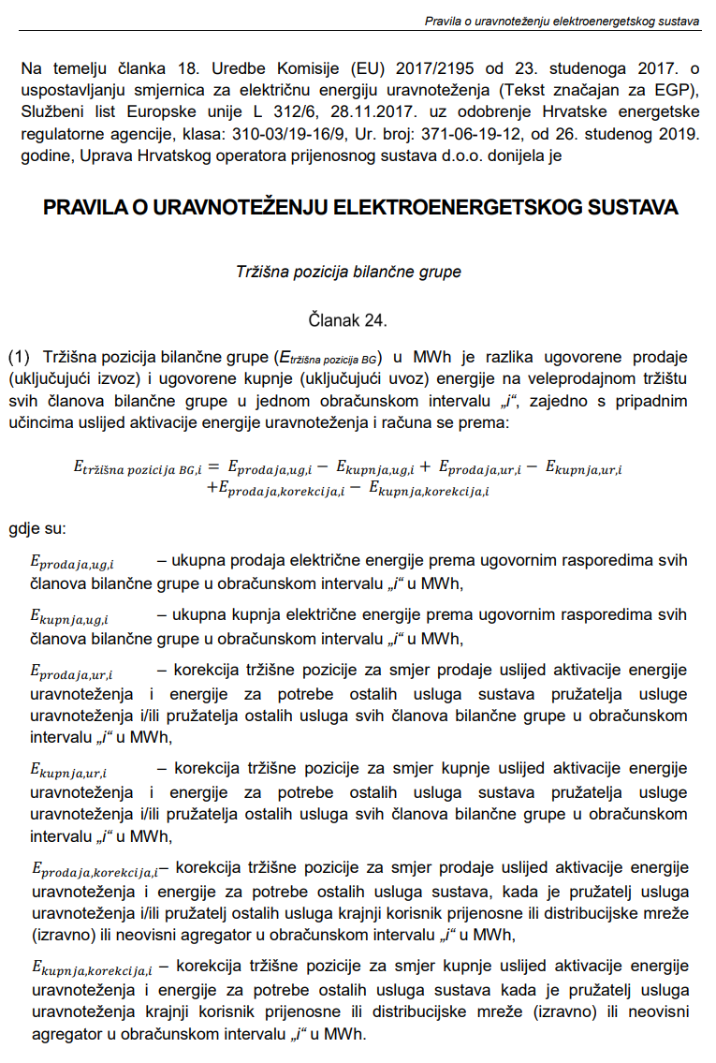
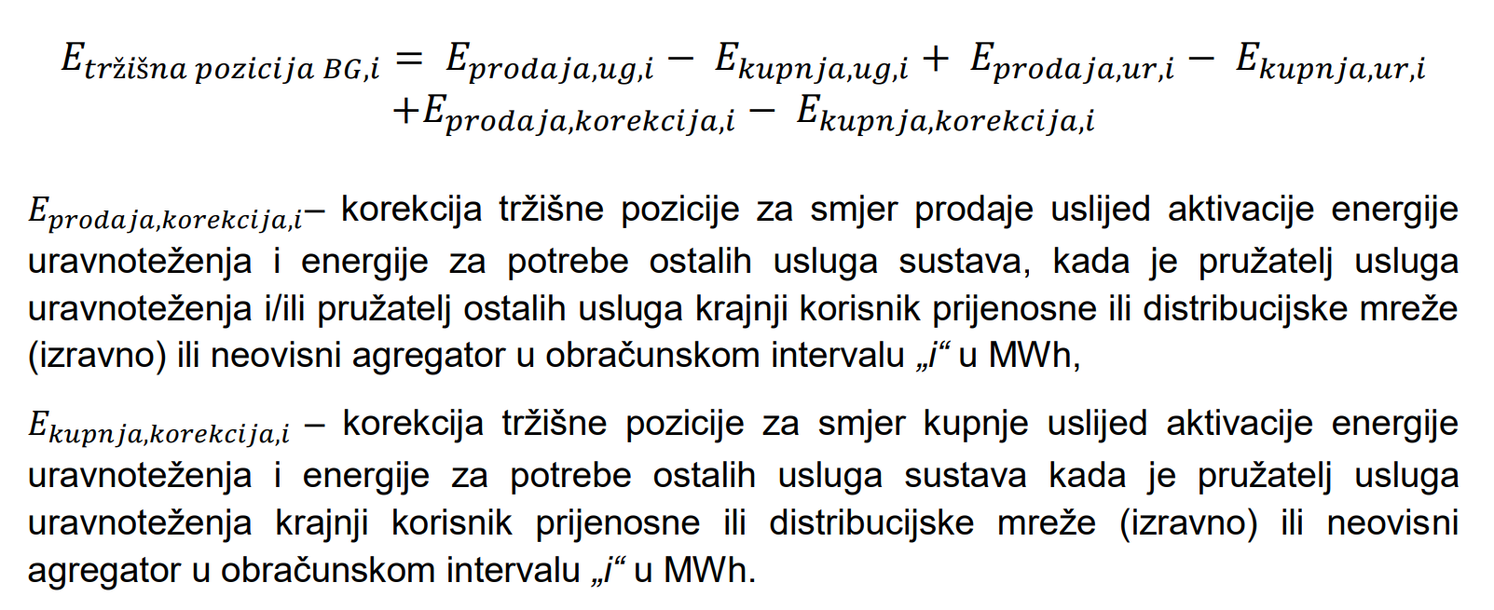
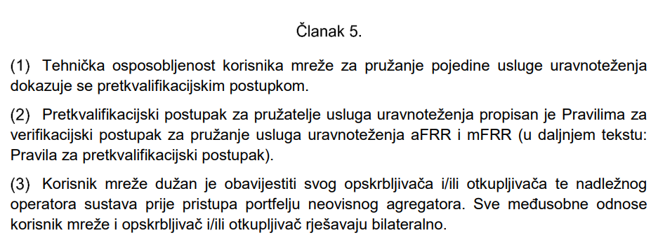
What has been prescribed for independent aggregator regarding compensation to supplier (3/4)

Slide 28
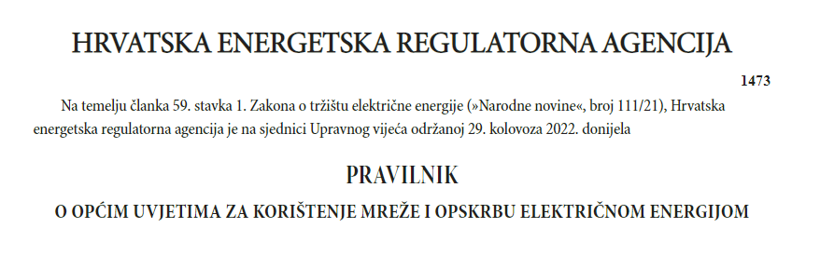
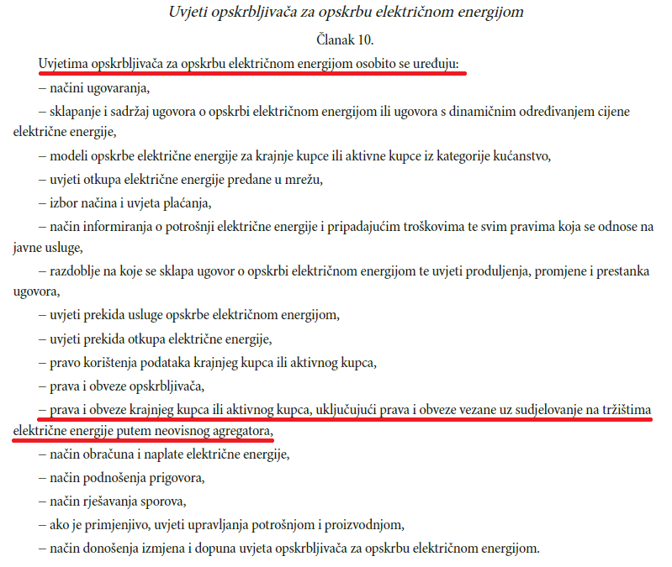
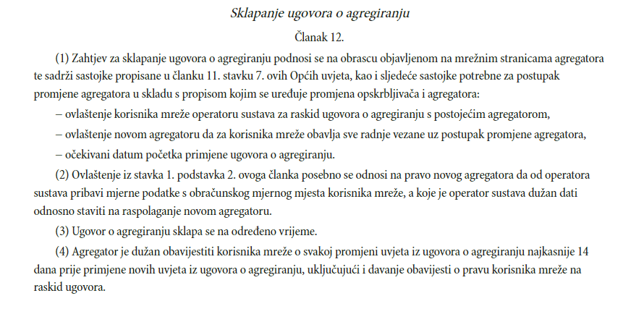



What has been prescribed for independent aggregator regarding compensation to supplier (4/4)

Slide 29



Holistic theoretical overview on the electricity market with aggregator
Taken from https://hro-cigre.hr/wp-content/uploads/2022/07/Filozofija_09simpozij_zbornik.pdf, figure is translated

Slide 30
In conclusion
In RC, applicable legal framework, e.g. Balancing Rules of EES from 2017, (or most recent, from 2019), have not restricted the entry of new stakeholders who would provide flexibility services to HOPS, and this framework has not been included in the details of the entry procedure (subsidiarity and proportionality, e.g. HOPS changes the contract forms and pre-qualification procedure as needed, freedom to establish pilot projects)
In RC, the pilot projects have led to use of inactivated resources of flexibility in the system (new stakeholders, e.g. independent aggregator for mFRR for security), what brings direct benefits to the society because flexibility needs in Europe are growing, and so do the opportunities (international exchange is possible)
Along with the entity that had had the monopoly, the new stakeholders entered the flexibility providing services in 2020, independent aggregator appeared in 2022 (reserve mFRR), mFRR for security market is currently (18 October 2022) completely open
A model should be designed with independent aggregator recognizing that this is an expert problem (necessary to take into account all calculations for individual stakeholders - buy and sell balance equations for calculating differences, reconciliation, etc.)

Slide 31
Thank you for your attention!

Slide 32
Reading (1/2)
Chondrogiannis, S., Vasiljevska, J., Marinopoulos, A., Papaioannou, I. and Flego, G., Local Electricity Flexibility Markets in Europe, Publications Office of the European Union, Luxembourg, 2022, doi:10.2760/9977, JRC130070, https://publications.jrc.ec.europa.eu/repository/bitstream/JRC130070/JRC130070_01.pdf
ebIx, Overview of energy flexibility services, siječanj 2020., https://mwgstorage1.blob.core.windows.net/public/Ebix/ebIX%20Overview%20of%20energy%20flexibility%20services%20-%20v1r0A%2020200106.pdf
ENTSO-E, EFET, ebIX, The harmonised electricity market role model, VERSION: 2022-01, https://eepublicdownloads.entsoe.eu/clean-documents/EDI/Library/HRM/Harmonised_Role_Model_2022-01.pdf
Davorin Brkić, Sustavko mišljenje i elektroenergetsko tržište u teoriji, https://hro-cigre.hr/wp-content/uploads/2022/07/Filozofija_09simpozij_zbornik.pdf, 2020.
Davorin Brkić, Holistički pristup i ilustracije za oslikavanje modela s HRO CIGRÉ-A iz 2015. koji sadrži ekonomske podsustave uravnoteženja, HRO CIGRE 2021., https://hro-cigre.hr/wp-content/uploads/2021/12/C5-02.pdf
Bertoldi P, Zancanella P, Boza-Kiss B.; Demand Response Status in EU Member States; EUR 27998 EN; doi:10.2790/962868, 2016., https://publications.jrc.ec.europa.eu/repository/bitstream/JRC101191/ldna27998enn.pdf

Slide 33
Reading (2/2)
ENTSO-E, Continental Europe Synchronous Area Separation on 08 January 2021 ICS Investigation Expert Panel » Final Report » 15 July 2021 Main Report, 2021., https://eepublicdownloads.azureedge.net/clean-documents/SOC%20documents/SOC%20Reports/entso-e_CESysSep_Final_Report_210715.pdf
Antun Andrić, Dalibor Sipl, Tonči Tadin, Josipa Jurjević, Pilot projekt upravljanja potrošnjom – iskustva i daljnji razvoj, HRO CIGRÉ, 2018., https://hro-cigre.hr/wp-content/uploads/2020/04/2-15-1.pdf
ACER-ovo sučelje vezano uz izradu novih smjernica za upravljanje potrošnjom, https://www.acer.europa.eu/events-and-engagement/news/acer-initiates-drafting-new-framework-guidelines-demand-response
HOPS-ovo sučelje za pružatelje resursa, https://www.hops.hr/usluge-uravnotezenja
Godišnja izvješća HERA-e (na hrv. https://www.hera.hr/hr/html/god_izv.html, na engl. https://www.hera.hr/en/html/annual_reports.html)
Mrežna stranica prvoga hrvatskoga neovisnoga agregatora, https://www.koer.com/
Popis važećih podzakonskih akata u Republici Hrvatskoj iz područja električne energije, https://www.hera.hr/hr/html/propisi_eenergija.html
Popis važećih energetskih zakona u Republici Hrvatskoj, https://www.hera.hr/hr/html/zakoni.html
Popis važećih direktiva i uredbi Europske unije koje se tiču energetike, https://www.hera.hr/hr/html/zakonodavstvo_eu.html

