Slide 2
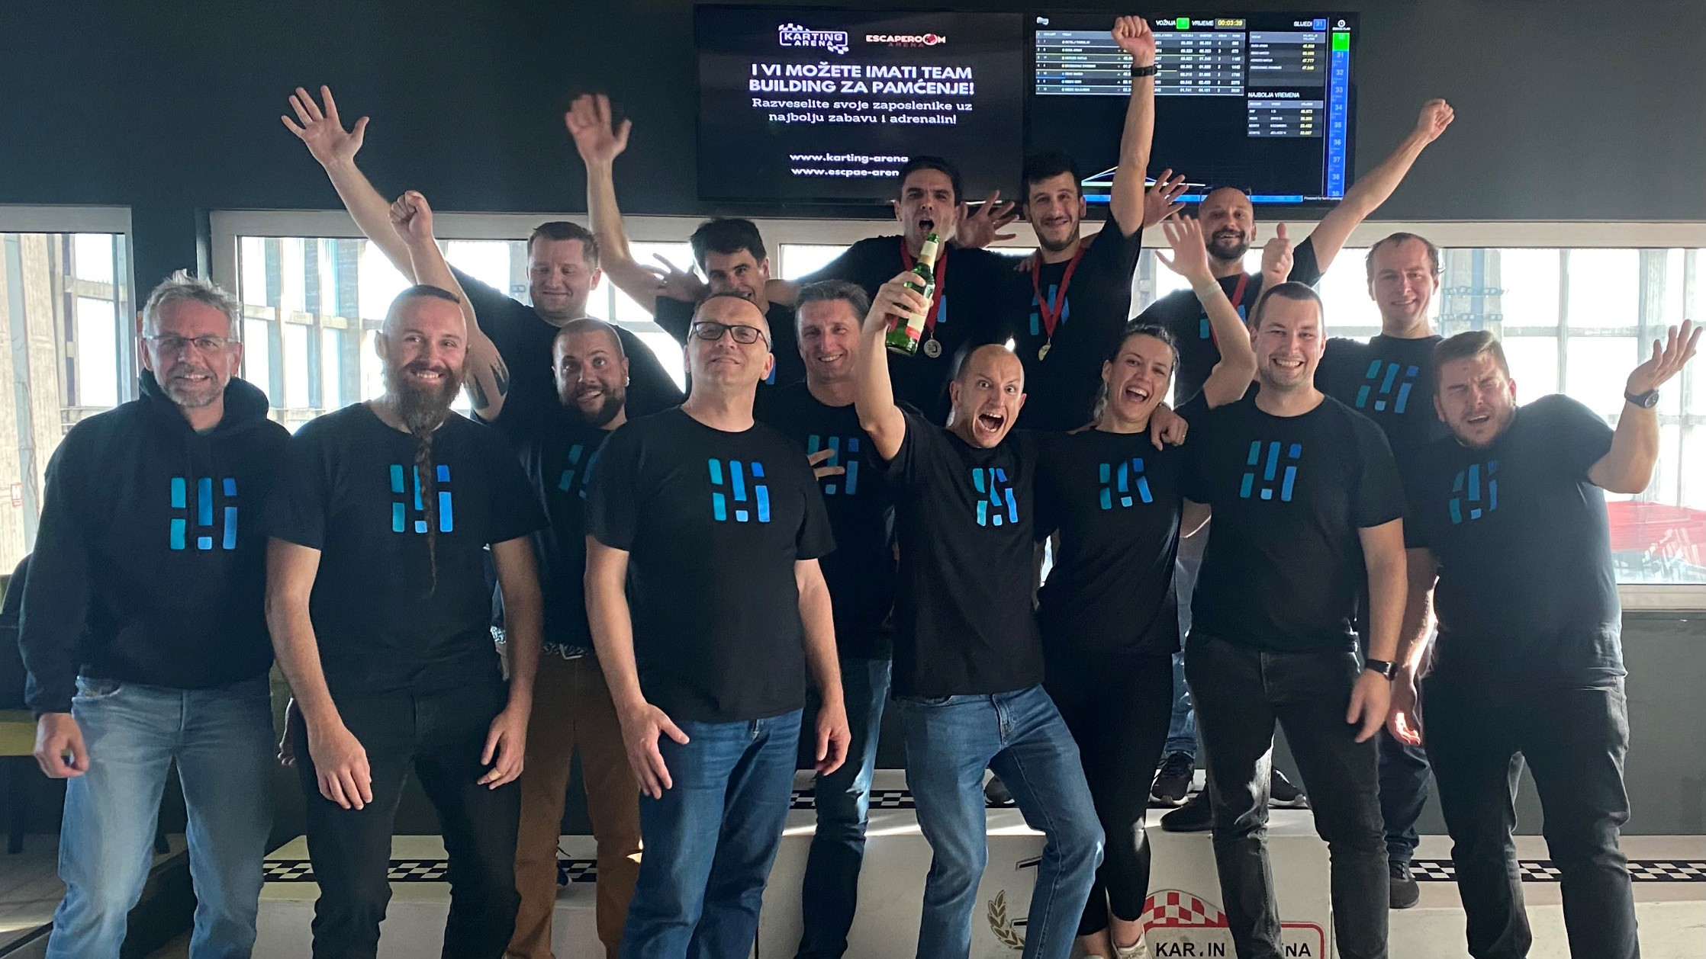

Slide 3
Who we are and what we wish to achieve
KOER wishes to accelerate the energy transition through the development of new infrastructure and systems necessary for the transition of the society to sustainable methods of energy production and consumption

Slide 5
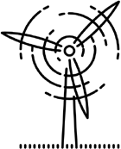
Virtual power plant
Electricity markets

Slide 6
What is a virtual power plant?
4. aggregation is an activity performed by a natural or legal person which may combine power and/or electricity taken from the grid from multiple customers or energy storage operators or power and/or electricity delivered into the grid by multiple producers or active customers or energy storage operators for the purpose of participation in any electricity market
Our activities impact the energy system just like typical energy facilities
We deliver or take energy from the system
The facility does not exist at a single location
We use technology to manage in a coordinated way and to create the necessary effect
We provide new properties through networking
- aggregation
We reduce complexity and uncertainty
We increase manageability, flexibility and predictability
Access to the electricity market

Slide 7
Infrastructure
KOER cloud
Operator
WEB app
Market
KOER box
KOER box
KOER mob app

Slide 8
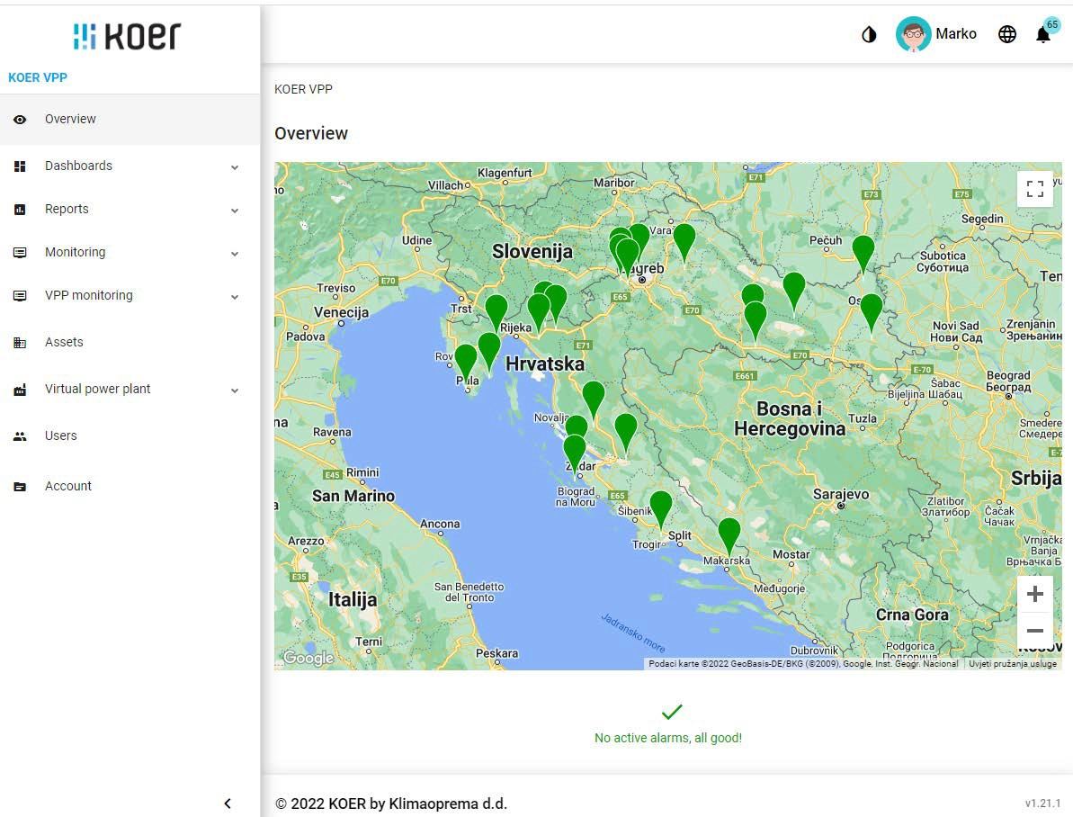
Cloud platform

Slide 9
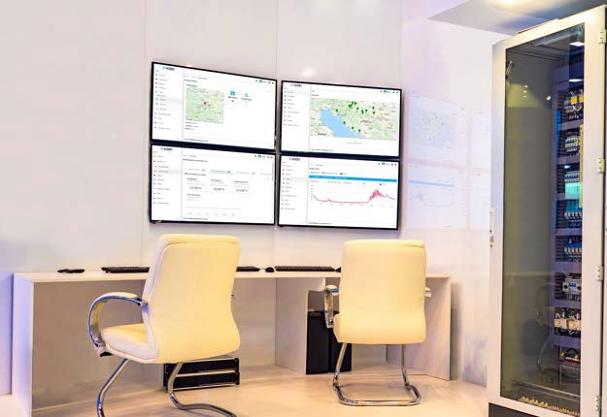
Control and Operations Center

Slide 10
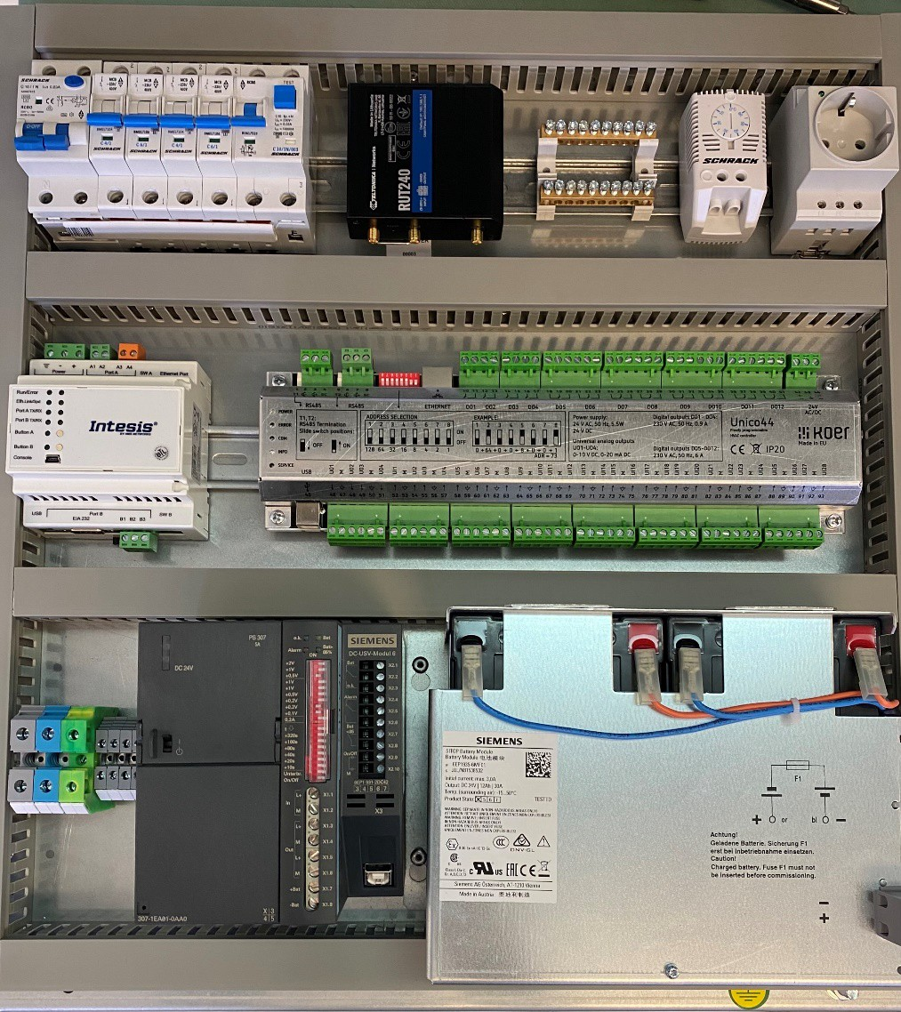
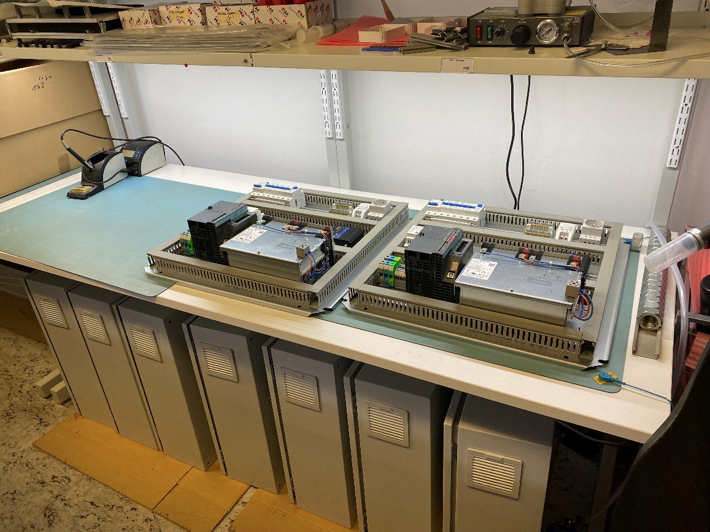
KOER box

Slide 11
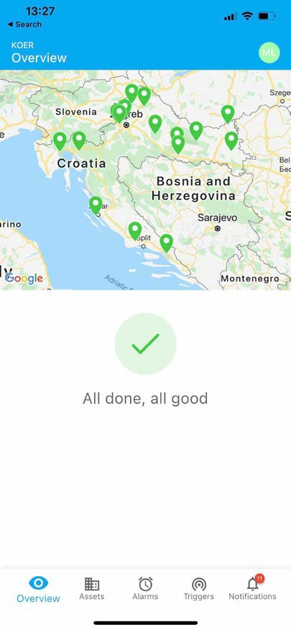
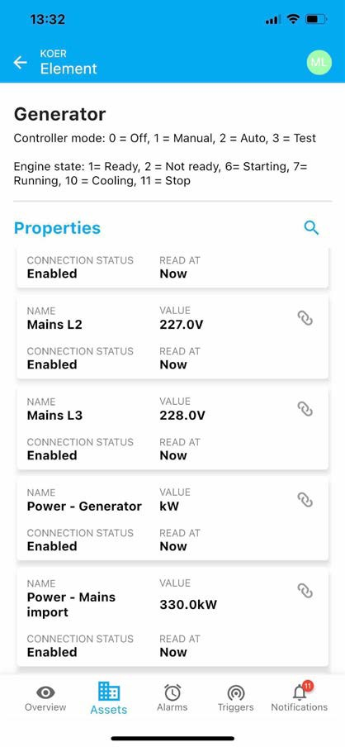
KOER mob app

Slide 12
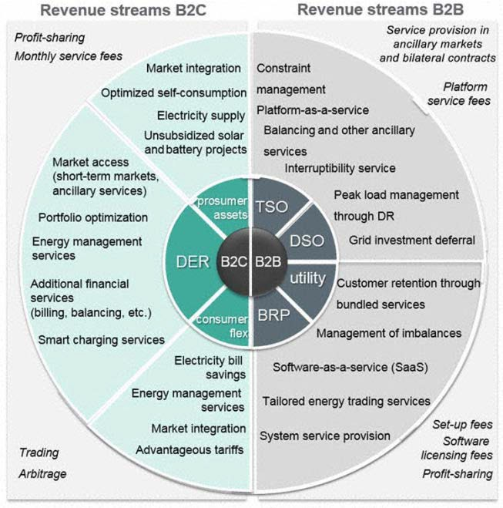
Virtual power plant business model

Slide 13
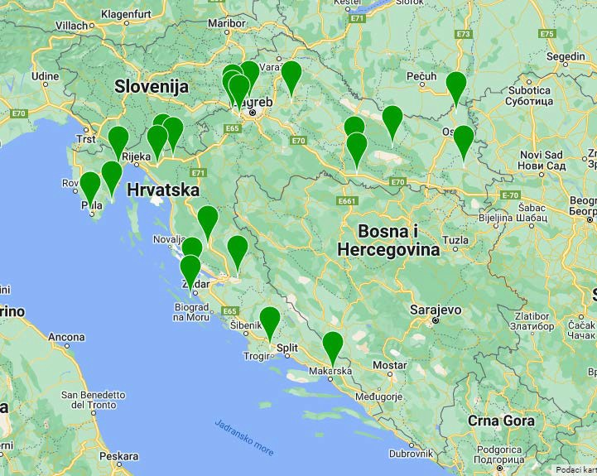
Types of distributed resources
Industrial facilities
From 0,5 – 17 MW
Communication infrastructure
Data centers
Transmitters

Slide 14
Ancillary services
mFRR (tertiary reserve, 15min, increase/decrease of generation/consumption)
Industry, utility infrastructure, redundant sources
Biogas facilities, HVAC systems
Wind power plants, solar
aFRR (secondary reserve, increase/decrease)
Battery storage systems
Biogas facilities
Production processes

Slide 15
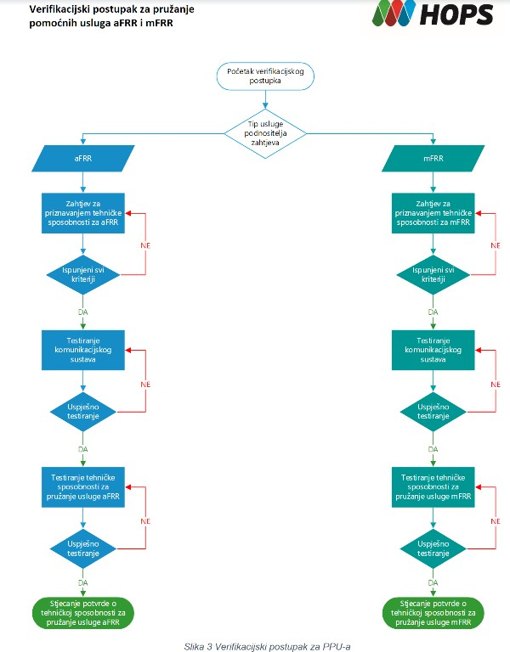
Verification process
Verification process for providing aFRR and mFRR ancillary services

Slide 16
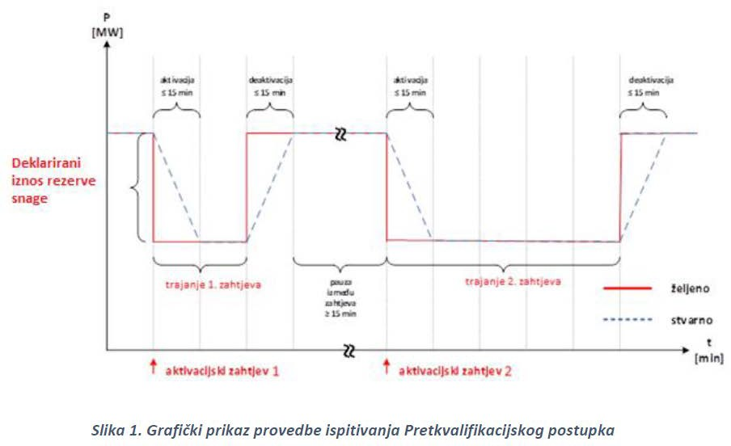
Technical capability testing
Figure 1. Diagram illustrating Prequalification Procedure testing

Slide 17
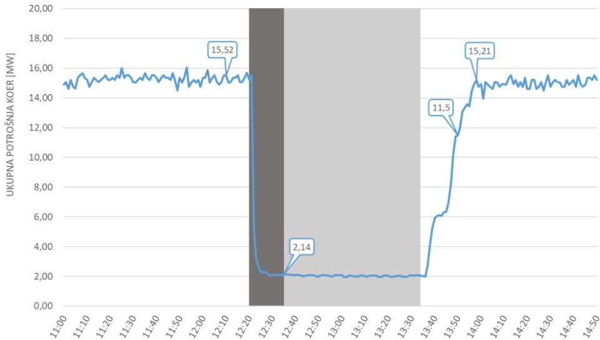
Technical capability testing

Slide 18
Experiences and obstacles at the market
Good cooperation with operators
Final customers slow in accepting new service
Slow digitalization of operators
Elements of the new Electricity Market Act
(6) Final customers who autonomously or through an independent agregator participate in demand response shall pay a fee to their supplier who is directly affected by the activation of demand response.

Slide 19
Revenue from mFRR
COMPETITION TO ENSURE mFRR RESERVE CAPACITY FOR SYSTEM SECURITY
Balancing product parameters:
mFRR reserve capcity for security
Minium size of the bid | 3 MW
Required activation time | ≤ 15 minutes
Minimum duration of activation | 30 min
Maxmimum duration of activation | 2 hours*
Time between two activations | 8 hours*
Direction of reserve | +
Price cap on mFRR reserve capacity | 48,73 HRK/MW**
Price cap on balancing energy | XX,XX HRK/MWh***

