Slide 1
Workshop - Integration of agreggators in the balancing market
Hrvatski operator prijenosnog sustava d.o.o.
October, 2022.

Slide 2
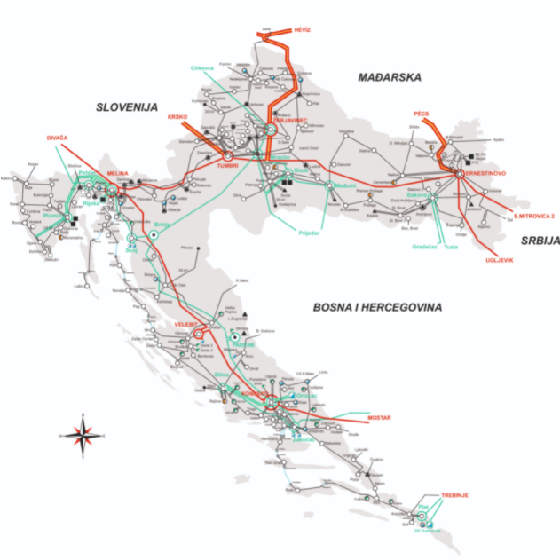
About HOPS
Croatian Transmission System Operator
  mission is electric power system operation and maintenance, electricity transmission, as well as construction and development of electricity transmission network in order to maintain security of supply with minimal costs and environmental protection
Capital: cca. 650 Mil.€
Ancilary services market: cca. 40 mil. €/Year
Balancing energy market: cca. +20/-10 mil. €/Year + international potential (with reference price of 50 €/MWh)

Slide 3
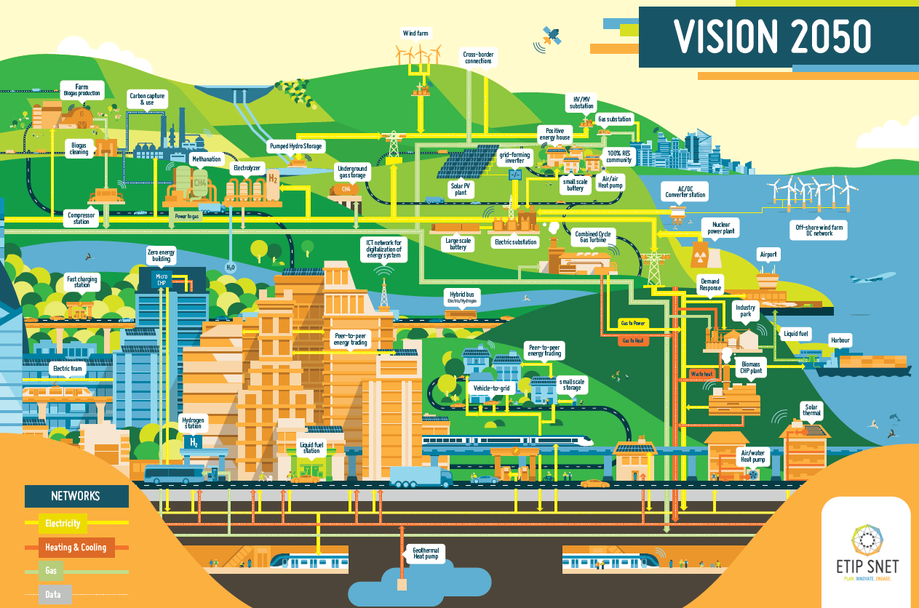

Slide 4
Where we are today?
mFRR market open for one balancing product
10 prequalified balance service providers (1 conventional, 1 aggregator, 8 controllable load), several in prequalification process
Daily tenders
Open for all technologies

Slide 5
Electricity markets in Croatia
Name | Amount | Pricing | Providers | Outlook | Aggregator
Frequency contaiment reserve -FCR | +/- 15 MW | Obligatory | Production units - transmission grid | Market based procurement + international potential | No
Automatic frequency restoration reserve -aFRR | +/- 35-75 MW | Regulated | Dominant BSP | Currently, no prequalified BSPs Market based procurement, Market development expected | Yes
Manual frequency restoration reserve -mFRR | -100/+250 MW | Regulated + Market based | Dominant BSP, prequalified BSPs | Further market development expected | Yes
Volatage control | - | Obligatory | Production units - transmission grid | Pilot for the local market considered | No
Black start/island operation | - | Regulated | Production units on transmission grid | Depends on the defense plan | No
Redispatching | - | Obligatory with predefined price | Production units - transmission grid | Increase in use expected, market mechanisms to be implemented where applicable | Yes
Wholesale electricity market | - | Market based | Market participants | New entities coming: energy communities, aggregators, renewable energy communities, storage, closed systems | Yes in ID

Slide 6
Historical overview
Methodology for ancillary services price determination (2016)
Pilot project – tertiary control(2018)
mFRR market(2020)
Agregators (2022)
Ancillary services – regulated procurement (2017)
Guideline on electricity balancing (11/2017)
Balancing code HR (11/2019)
Electricity market law (2021)
EU platforms (2023/4)

Slide 7

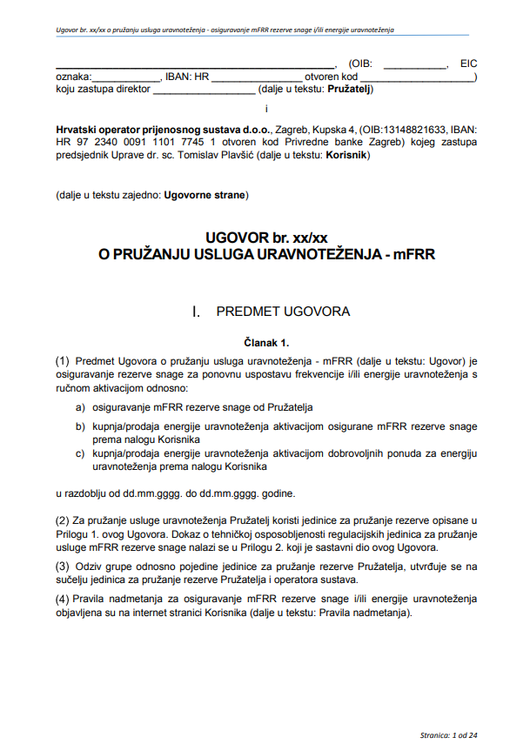
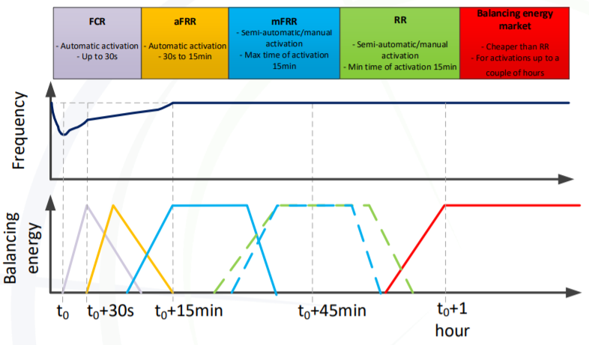
mFRR market introduction
Started with pilot project
Transparency
Price caps

Slide 8
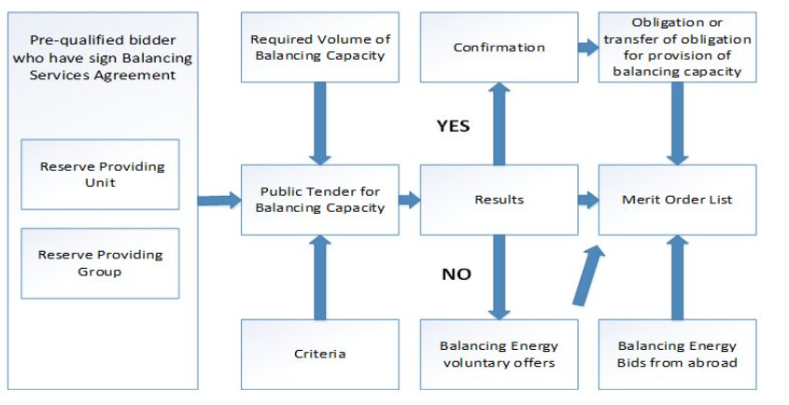
mFRR product for system security
Schematic representation of the procurement process:
Balancing product parameters:
mFRR product
Minimum bid quantity | 3 MW
Full activation time | ≤ 15 min
Minimum duration of delivery period | 30 min
Maximum duration of delivery period | 2 hours*
Time between two activations | 8 hours*
Direction | +
Balancing capacity price limit | XX,XX HRK/MW
Balancing energy price limit | XX,XX HRK/MWh

Slide 9
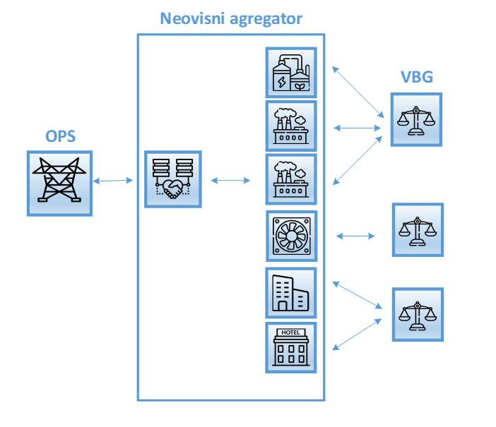
Aggregator
Independent aggregator
two options: independent participation or through an aggregator
agregator – indepentend or supplier (BRP)
balancing services can be provided by technical units having different technologies
facilities can be connected to the transmission and/or distribution network
correction of the BRP schedule foreseen during activation (BRP to be financially neutral)
BRP
TSO

Slide 10
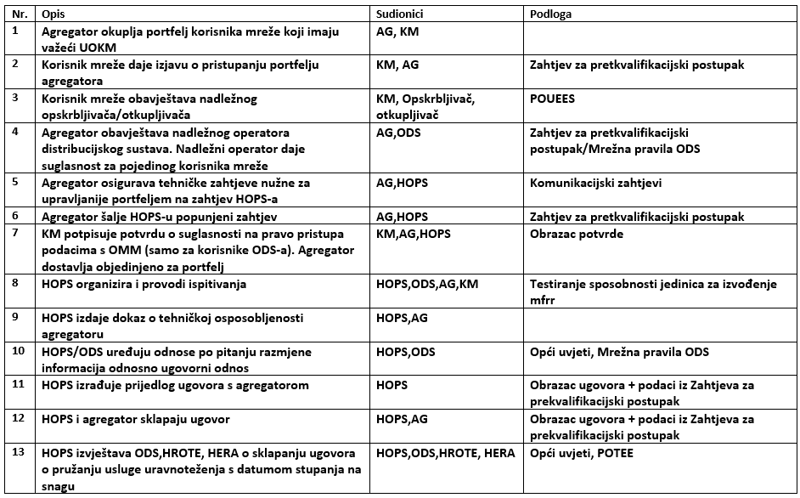
Agregator - steps
Agregator (AG)
Aggregated asset (KM)
Transmision system operator (HOPS)
Distribution system operator (ODS)
Suppplier
Market Operator (HROTE)
National Regulatory Agency (HERA)

Slide 11
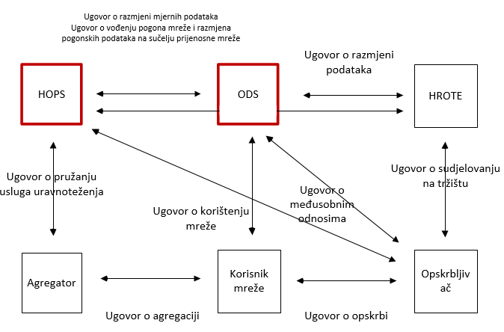
TSO/DSO cooperation
TSO/DSO cooperation essential for implementation
Grid security has a priority always
Operators to exchange information in all phases: Prequalification, Contracting, Bidding, Acctivation, Constraints
In future: agregated assets could be used also in DSO grid (e.g. congestion management and voltage control)

Slide 12
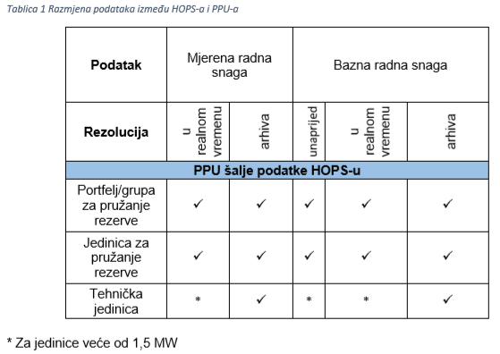
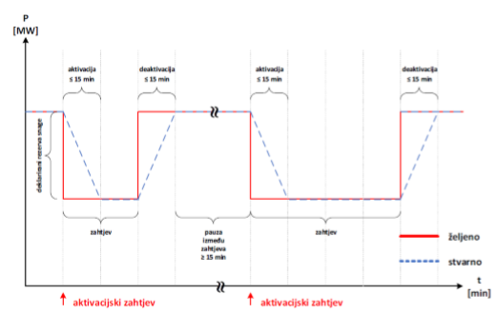
Prequalification: mFRR (manual, 15 min)
https://www.hops.hr/pretkvalifikacijski-postupak

Slide 13
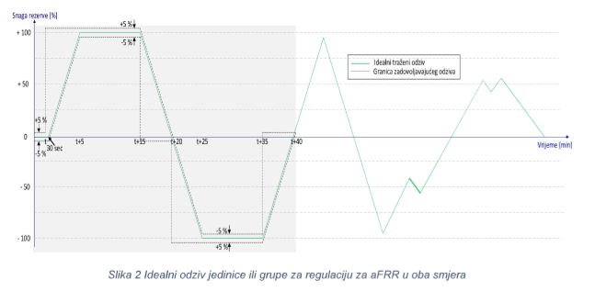
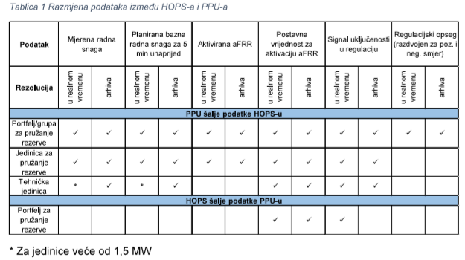
Prequalification: aFRR (automatic, 5 min)
Automatic activation

Slide 14
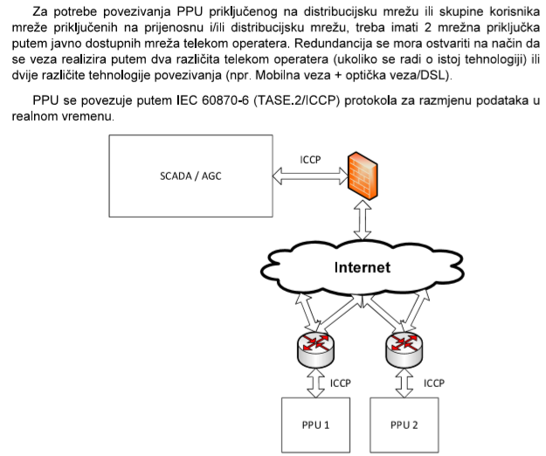
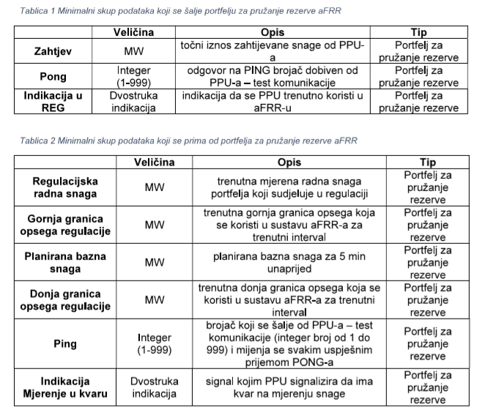
Prequalification: communication prerequesits

Slide 15
Conclusion
Aggregators could bring to balancing market liquidity with significant number of assets
Transparent rules needed (Prequalification, Balancing code, Rules for procurement)
Price caps, shorter procurement periods, dedicated product requirements may help in the initial phase of market development
TSO/DSO cooperation is a prerequisite for assets connected to DSO level
All stakeholders should be included (Asset owner, NRA, TSO, DSO, BSP, BRP)

Slide 16
Thanks for Your attention

