Slide 1
GUIDELINES FOR THE IMPLEMENTATION OF AGGREGATORS IN BiH
Neum, October 19-20, 2022

Slide 2
USAID EPA – TECHNICAL ASSISTANCE
Prepared documents
Report on International Practice – April 2020
Aggregators Gap Analysis of BiH Legal and Regulatory Framework – September 2020
Aggregator Model – April 2021
Aggregator Implementation Guidelines – October 2021

Slide 3
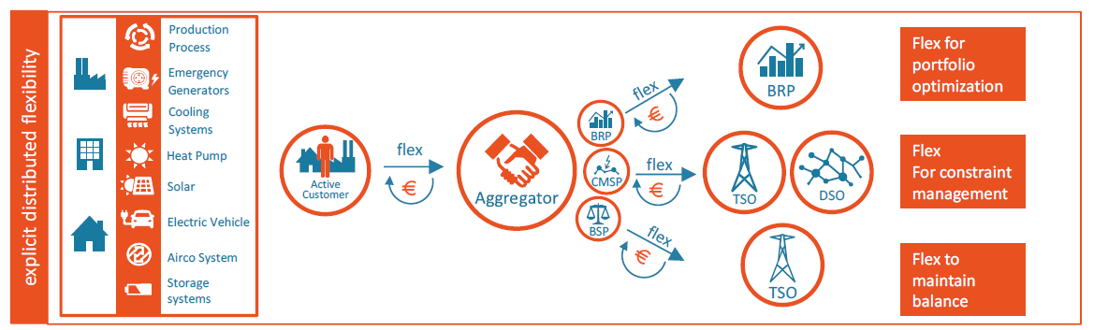
Aggregator Model
Role of the aggregator
Supplier
Independent aggregator
Independent aggregator in cooperation with the supplier
Izvor: USEF

Slide 4
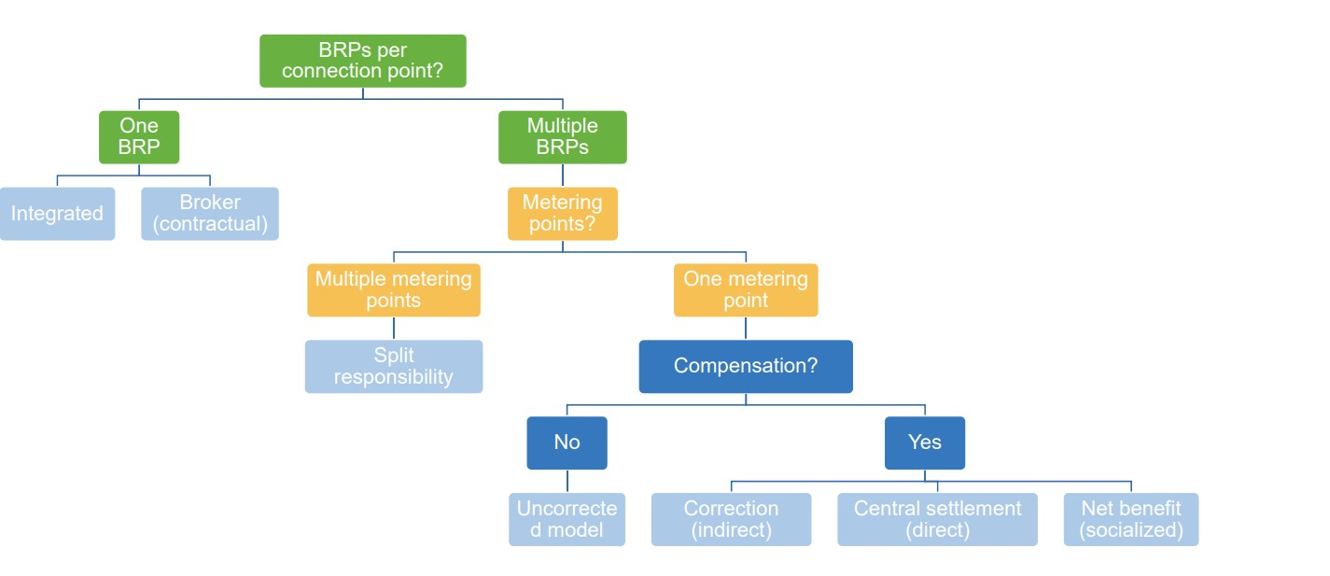
Aggregator Model
Breakdown of the aggregator model:
With one or two BRPs
With/without compensation for received energy
Compensation implementation method
Izvor: ACER

Slide 5
Aggregator Model
Possible implementation models of independent aggregator in BiH:
Model with contracting
Model with central settlement
Type of service | Type of aggregator
 | Supplier-aggregator and hybrid concept | Independent aggregator
Wholesale market | Integrated model | Model with contracting
Balancing market aFRR
Balancing market mFRR
Congestion management at distribution level | Bilateral

Slide 6
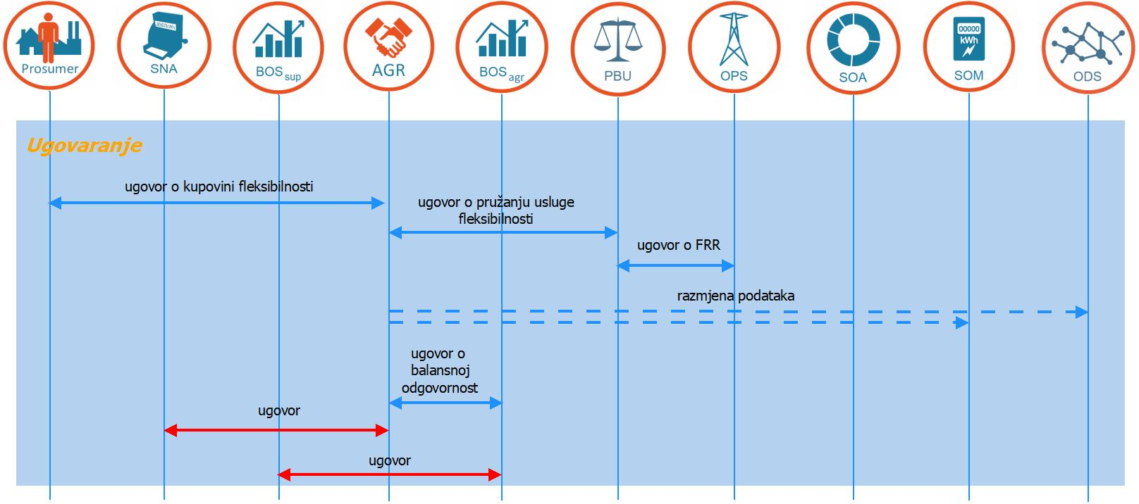
Aggregator Model
Model with contracting – Contractual relations
Source: USEF

Slide 7
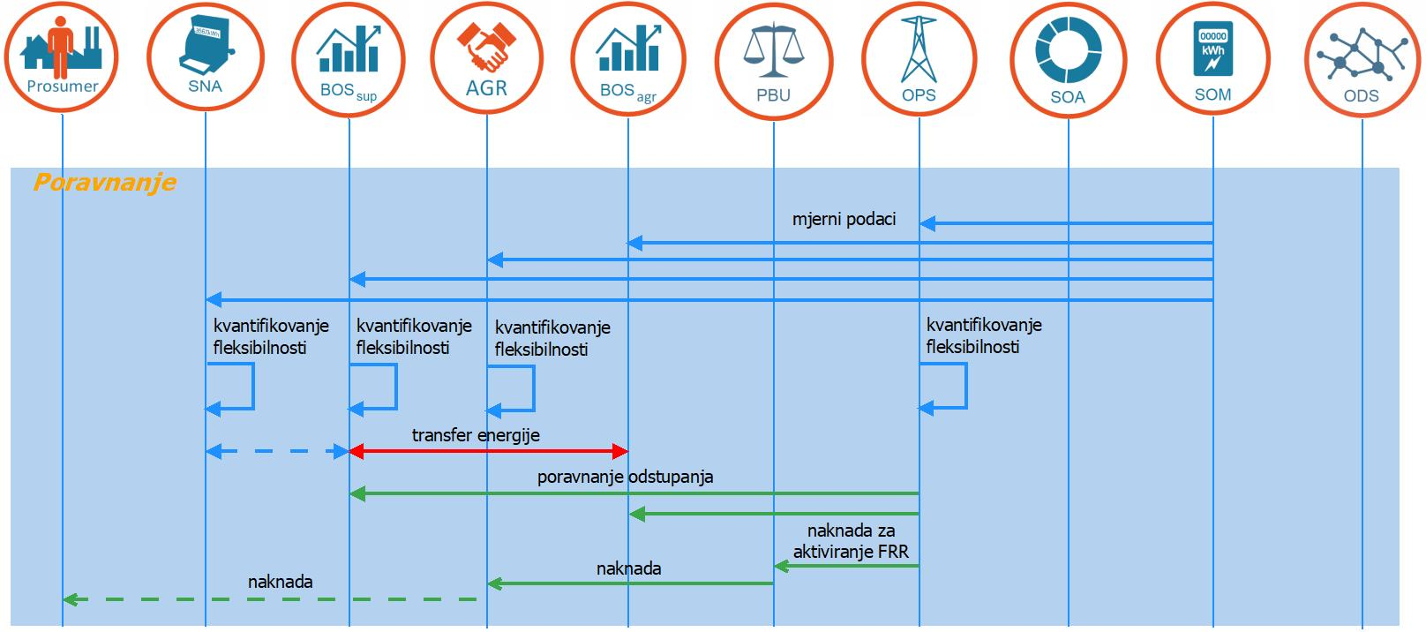
Aggregator Model
Model with contracting – Quantification
Izvor: USEF

Slide 8
Implementation guidelines - Contents
General issues
Commercial requirements
Technical requirements
Prequalification
Planning and activation of flexibility services
Settlement of flexibility services
Data exchange

Slide 9
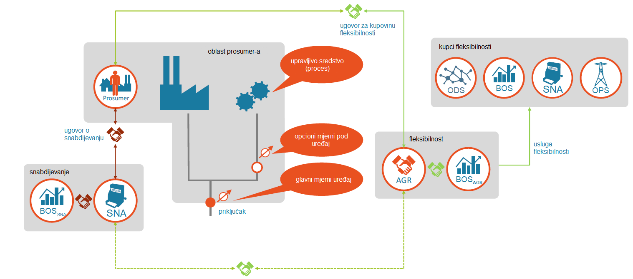
Implementation guidelines – General issues
Source: USEF

Slide 10
1. Implementation guidelines – General issues
Definition of the terms aggregator and aggregation
Right of aggregator to participate in the market
Aggregator model
Licensing of aggregators
Roles and tasks of aggregators
Aggregator‘s balancing responsibility
Delivery points of BRP aggregator
Contractual relations for the selected aggregator model

Slide 11
2. Implementation guidelines – Commercial requirements
Source: ENTSO-E

Slide 12
2. Implementation guidelines – Commercial requirements
Right of aggregator to participate in the market
Characteristics of products at the balancing market
Ancillary services procurement time schedule
Time of delivery of bids for the provision of ancillary services
Methodology for setting prices of ancillary services
Congestion management services at the distribution level

Slide 13
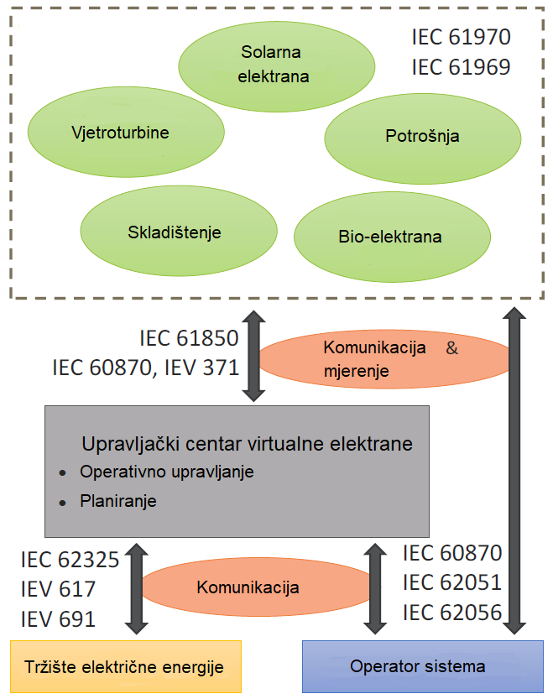
3. Implementation guidelines – Technical requirements
Redundancy of the aggregator control center
Requirements of IT and telecom systems
Requirements for energy measurements
Real-time measurement and statuses
Aggregator – TSO control center communication

Slide 14
4. Implementation guidelines – Prequalification
Prequalification rules
Prequalification procedure
Source: Regelleistung

Slide 15
5. Implementation guidelines – Planning and activation of flexibility services
Baseline diagram and development methodology
Simultaneous provision of multiple services
Activation of services

Slide 16
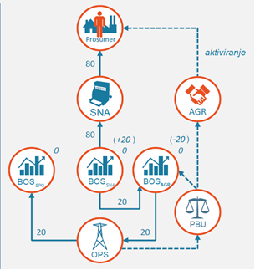
6. Implementation guidelines – Settlement
Delivery of billing data
Quantification
Calculation of imbalances
Energy settlement
Value of transferred energy
Payment for provided services
Source: USEF

Slide 17
7. Implementation guidelines – Data exchange
Supplier – aggregator – balance responsible party communication:
  Access to metering data
  Information on contract concluded between the service provider and the aggregator
  Information on activated flexibility services
  Price of energy component with the supplier

Slide 18
Implementation of guidelines in BiH
Complex legal and regulatory framework in BiH
Division of competences of regulatory bodies and other relevant stakeholders
FBiH Law on Electricity
  Definition of terms
  Licensing
  Activities of the aggregator
  Contractual relations

Slide 19
EU legislation
Directive EC 2019/944
ACER Framework Guideline on Demand Response
USEF – Aggregator’s framework

Slide 20
Thank you
mr Dalibor Muratović
Electricity expert
dmuratovic@usaidepa.ba

