Slide 1
Energy Transition
Aggregator
an important new market player delivering demand side flexibility
Introducing the most crucial elements of the European and Hungarian legal-regulatory framework of aggregators
dr. Gábor SZÖRÉNYI
Former Chairman and General Secretary of ERRA
Former Director of HEO (Hungarian Regulatory Authority)

Slide 2
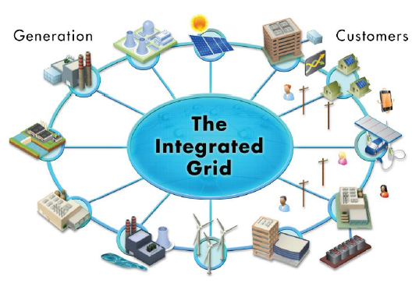
Topics for Discussion
Importance of flexibility and especially Demand Side Flexibility – Role of Aggregators
Introducing the most crucial elements of the European and Hungarian legal-regulatory framework of aggregators
General experience of the aggregators (market entry, operation) in the EU
Former Aggregator’ like experience in Hungary
Lessons learned from the Public Consultation on Aggregation managed by the Hungarian Regulator (HEA/MEKH) - concerns of incumbent trades/suppliers, DSOs and TSO; entry barriers mentioned by the potential aggregators

Slide 3
  Retail markets and consumer involvement in the Clean Energy Package (CEP)
  Strengthened consumer rights;
    to dynamic electricity price contract
    → room for smart metering and new supply offers
    for aggregation → potential new market entrants (aggregators and energy communities as competitors of present suppliers)
    to generate, store, consume and sell self-generated power
    → new, innovative business potential for 3rd party
    to actively participate in Demand Side Response programs
    → new possibility for DSOs in system regulation/operation
    to have access to consumption related data → new uniform data format and access rules

Slide 4
Importance of flexibility and especially Demand Side Flexibility – Role of Aggregators
SEMI: „ On the electricity market of the future, with a higher proportion of variable electricity production in the form of wind and solar power, it will be important to utilise all the flexible resources in the electricity system, including flexible production, storage and demand side flexibility (less need for new generation and network development, less utilisation of polluting plants, better system optimization).. ”
The Swedish step by step approach and the consensus based Market Design elements (aggregation, local energy communities, supportive framework for storage) and the customer focused, flexible regulation could be good examples.
SEMI: Swedish Energy Markets Inspectorate

Slide 5
Why we need a flexible power system and network?
The precondition for a secure supply of electricity is in the first instance a balance of electricity generation and consumption at all times. In the past, it was primarily the load to be met that was unplannable and unpredictable. In the wake of the energy transition, however, variable and intermittent generation from renewable energy sources is becoming increasingly important. In the medium term, more than half of the electricity generated is expected to come from renewables. This means that conventional electricity generation will need to be tailored more to the residual load (electricity consumed minus generation from renewable sources). As the percentage of renewables in the electricity mix rises, the residual load can frequently decrease to almost zero and then increase significantly within a short window of time – either days or hours. The actors in the system therefore need more flexibility to be able to efficiently guarantee security of supply.
Source: Bundesnetzagentur: Flexibility in the electricity system – April, 2017

Slide 6
Residual load curve
Source: Arnold Johan Rix, Stellenbosch University

Slide 7
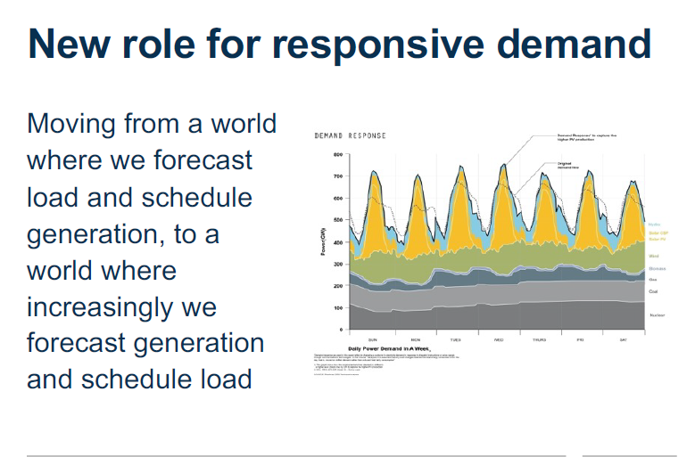
Demand Side Flexibility as an Important Active Element of System Operation in the Energy Transition

Slide 8
Some elements of the changes: Renewable integration creates System-operation challenges
From System Operator point of view:
• Increasing amount of balancing capacity need
• The reliability of sources are decreasing
• The inertia of the system is decreasing
• The energy flow is depending on the weather conditions; which could cause grid congestions
• The executions of maintenances are depend on the weather conditions
• The occurrence and level of re-dispatch will most probably increase

Slide 9

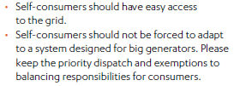
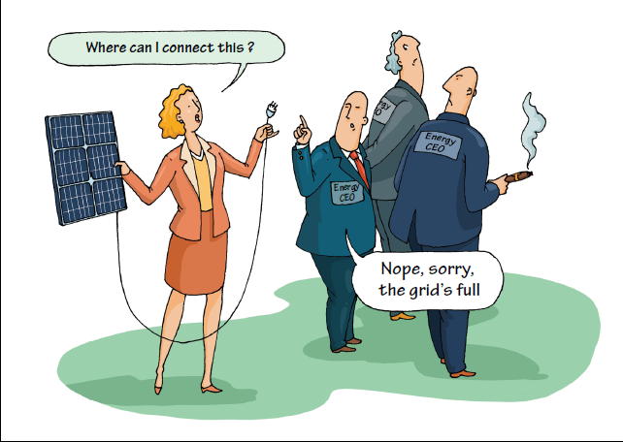
New network connection procedure of renewable generators into the DSO system is too long and sometime constrained
Well prepared regulatory incentives should support potential flexibility sources assisting network (system) operation! (Avoiding stranded asset through network development!)
The storage technology and the Demand Side Flexibility could help to postpone network development!

Slide 10
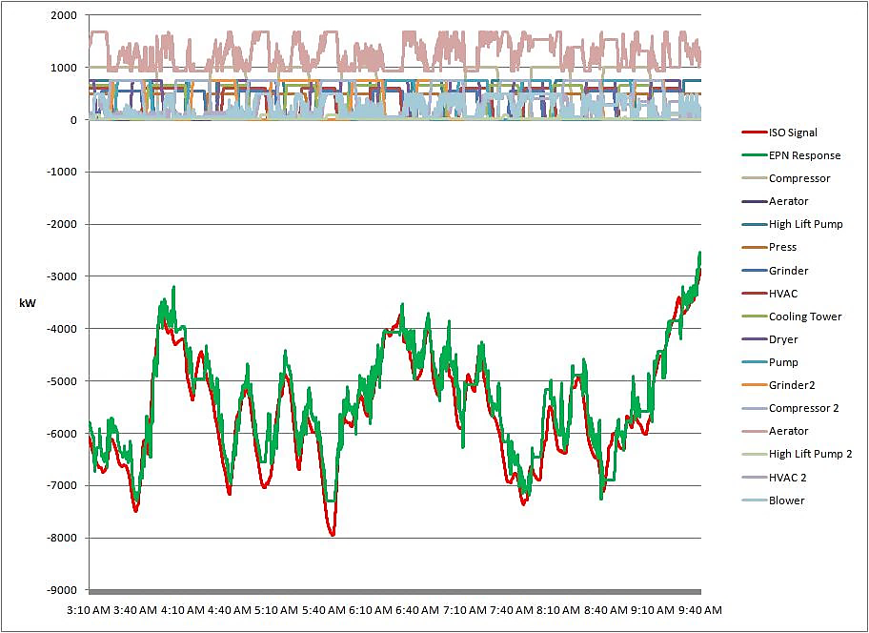
Aggregators are key actors in the Demand Side Flexibility
The aggregate response of each flexible resource in the network-system is compiled to form a unified regulation response.

Slide 11
Introducing the most crucial elements of the European and Hungarian legal-regulatory framework of aggregators (1)
DIRECTIVE (EU) 2019/944 OF THE EUROPEAN PARLIAMENT AND OF THE COUNCIL of 5 June 2019 on common rules for the internal market for electricity and amending Directive 2012/27/EU
Article 17: Demand response through aggregation
1. ”Member States shall allow and foster participation of demand response through aggregation. Member States shall allow final customers, including those offering demand response through aggregation, to participate alongside producers in a non-discriminatory manner in all electricity markets.”
2. ”Member States shall ensure that transmission system operators and distribution system operators, when procuring ancillary services, treat market participants engaged in the aggregation of demand response in a non-discriminatory manner alongside producers on the basis of their technical capabilities.”
(Ancillary services cover different reserve markets, balancing,…)

Slide 12
Introducing the most crucial elements of the European and Hungarian legal-regulatory framework of aggregators (2)
4. ”Member States may require electricity undertakings or participating final customers to pay financial compensation to other market participants or to the market participants' balance responsible parties, if those market participants or balance responsible parties are directly affected by demand response activation. Such financial compensation shall not create a barrier to market entry for market participants engaged in aggregation or a barrier to flexibility.”
„…. the financial compensation shall be strictly limited to covering the resulting costs incurred by the suppliers of participating customers or the suppliers' balance responsible parties during the activation of demand response.”
„…. calculating compensation may take account of the benefits brought about by the independent aggregators to other market participants….. calculation method shall be subject to approval by the regulatory authority….”
Financial compensation in Hungary: The Act does not require such compensation (due to the relative small number of active aggregators and the lack of method calculating the identified cost occurred at effected suppliers and the benefit brought by the aggregators)

Slide 13
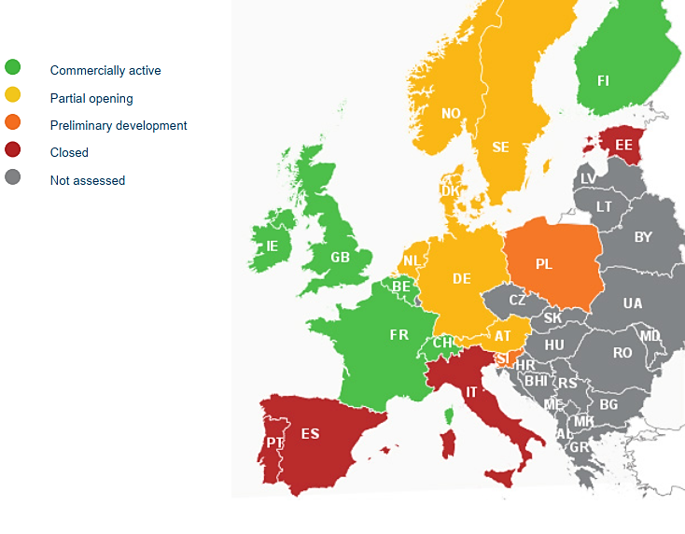
There were rooms for development in Demand Response in Europe in 2017
Where is DR commercially active in Europe?
Source: Smart Energy Demand Coalition (SEDC), 2017

Slide 14
General experience of the aggregators (market entry, operation) in the EU
„Explicit Demand Response for small end-users and independent aggregators” - Status, context, enablers and barriers
This publication is a Science for Policy report by the Joint Research Centre (JRC), the European Commission’s science and knowledge service.
Figure 2. Status of explicit Demand Response and Independent Aggregators (IA) across the EU Member States in 2021

Slide 15
„Explicit Demand Response for small end-users and independent aggregators” Status, context, enablers and barriers - Conclusion of JRC Report
Through a survey, expert interviews and desk research, this report has found that as the transposition of Article 17 into national law is ongoing, most of the EU Member States already enable participation in explicit Demand Response, but not necessarily through an independent aggregator. The main findings indicate that the status of explicit DR has improved, but not equally across the MS, and especially not with regard to small end-users. The possibility to aggregate and access the markets through independent aggregators depends on well-enabled participation in explicit DR.
Apart from strong participation in explicit DR, independent aggregators require further enablers in the form of an appropriate regulatory framework (secondary legislation), a functional market (fair and transparent compensation mechanisms), technical preconditions (advanced roll-out of smart meters) and a convincing business case (strong participation of end-users in DR and/or permission for value stacking). Barriers from additional categories (e.g., data privacy concerns) still need to be addressed appropriately.

Slide 16
Demand-side flexibility in the EU: Quantification of benefits in 2030 September 2022 (SmartEn, DNV): Some Conclusions (1)
In the year 2030 the model estimates a total of 164 GW upward flexible power and 130 GW of downward flexible power. With an activation of 397 terawatt hours (TWh) of upward DSF and 340.5 TWh of downward DSF the following results are found:
€4.6 billion (5%) are saved due to lower costs to generate electricity compared to a scenario without DSF.
The power system could serve all demand all year long, saving €9 billion on ‘lost load’ not served by the available generation.
Renewable energy curtailment would be 15.5 TWh (61%) less, improving the economics of renewables and the availability of decarbonized electricity to consumers.

Slide 17
Demand-side flexibility in the EU: Quantification of benefits in 2030 September 2022 (SmartEn, DNV): Some Conclusions (2)
In the year 2030 the model estimates a total of 164 GW upward flexible power and 130 GW of downward flexible power. With an activation of 397 terawatt hours (TWh) of upward DSF and 340.5 TWh of downward DSF the following results are found:
37.5 million tonnes (Mt) would be saved in annual GHG emission
Direct benefits could lead to a potential cost reduction for consumers of more than €71 billion (64%) per year on electric consumption.
Over €300 billion in indirect annual benefits to people, communities, and businesses would result from reductions in energy prices as a whole, generation capacity costs, investment needs for grid infrastructure, system balancing costs, and carbon emissions.

Slide 18
Former Aggregator’ like experience in Hungary
40 years experience with Demand Side Management of volunteering consumers operating electric boilers and electric space heater though Ripple Control technics:
  More then 600 MW peak saving (demand shifting)
  Special tariff for these appliances
  Harmonized schedule of switching among TSO and DSO/supplier
5+ years experience with aggregated gas motors (regulation centres):
  Active and successful participation on the TSO’ secondary reserve (aFRR) market
  Experience with the different flexibility products and software development with aim of optimising the operation of flexible units and maximising profit
  The active „regulation centres” investing in battery storage technology

Slide 19
Lessons learned from the Public Consultation on Aggregation managed by the Hungarian Regulator (HEA/MEKH) (1)
As of January 1, 2021, the Hungarian energy legislation was amended to transpose the Clean Energy for All Europeans Package (‘CEP’). These changes have allowed new entrants, including aggregators, to enter the electricity market.
In order to develop the appropriate rules and codes (detailed legal, technical and IT background regulations, implementation rules), it was necessary to review the opinions and suggestions of the interested parties, therefore, in summer 2021 MEKH conducted a questionnaire consultation involving domestic and foreign market participants, industry advocacy groups as well as national regulatory authorities of other countries.
MEKH summarized, anonymized and published (on its Website) the answers for public consultation, highlighting the regulatory issues considered most important. You may find the summary of the key regulatory issues MEKH identified pursuant to the questionnaire in English.

Slide 20
Lessons learned from the Public Consultation on Aggregation managed by the Hungarian Regulator (HEA/MEKH) (2)
Participants in the consultation process:
  TSO (MAVIR), DSOs, PX (HUPX)
  Traders (representing the active market players of 178 different licensed traders/suppliers
  Regulated tariff suppliers
  Generators (mostly the flexible gas fired ones)
  Renewable generators
  Aggregators (representing the 34 registered aggregators)
  smartEn, DR4EU, RAP (Regulatory Assistance Project)
  CRE, BNetzA
Steps of Consultation: published questioner (22 questions) – collected and analysed answers – published summary of answers and preliminary regulatory position – possibility of new comments – one day on-line consultation with presentations of the representatives of the different interest – final conclusion is under preparation

Slide 21
Lessons learned from the Public Consultation on Aggregation managed by the Hungarian Regulator (HEA/MEKH) (3)
Key regulatory issues MEKH considered most important
I. Relationship between aggregator and trader
Difference between aggregation and trade from a regulatory point of view
  Since in Hungary, the trade of energy is subject to authorization by MEKH, whereas aggregation is not (it is „only” subject to a simplified registration procedure) it is important to determine precisely what an aggregator can and cannot do without a trader’s license.
  Connection between aggregator and trader
    Contractual relationship
    Data transfer
Responsibility for imbalance (According to the provisions of the Directives and Regulation, the imbalance of the aggregator is the difference between the volumes of DR he delivers (his "allocated volume") and the volumes of his net sales (his "final position in the market"). Thus the aggregator should be responsible to match sales with deliveries, exactly as a generator should. If the aggregator delivers exactly the volume of DR equal to his sales in the market, he has no imbalance.)
    Compensation for the lost profit of the trader

Slide 22
Lessons learned from the Public Consultation on Aggregation managed by the Hungarian Regulator (HEA/MEKH) (4)
Key regulatory issues MEKH considered most important
II. Aggregation of market players in different balance groups
It is a key regulatory focus point that the aggregator shall be able to aggregate market participants (power plants, users and electricity storage facilities) from different balance groups, and to set the rules for the services provided by the aggregator, accounting for the balancing energy. The Hungarian TSO (MAVIR) is already preparing a transitional concept, which it plans to introduce in some markets (aFRR, then later FCR and mFRR) from 1 January 2022.
III. Portfolio accreditation of demand side flexibility
It is necessary for the accreditation (prequalification) process to be group-based in aggregation of demand-side flexibility, i.e. at portfolio level. Accordingly, it is necessary to develop detailed rules for the aggregate offering of services and the exact settlement processes.
IV. Metering
Several parties suggested accepting smart meters and the aggregator's own metering units to measure the consumption of each piece of end-user’ equipment.

Slide 23
Lessons learned from the Public Consultation on Aggregation managed by the Hungarian Regulator (HEA/MEKH) (5)
Key regulatory issues MEKH considered most important
V. Development of baseline methodologies
In order to maximize the potential for flexibility, it is necessary not to exclude market participants from aggregation that are not able or obliged to provide a schedule. In their case, it is important to define a so-called baseline. A baseline is a ‘theoretical value calculated according to a fixed method that simulates what would have occurred if demand-side flexibility had not been activated’. Depending on the technology of each piece of equipment, there may be several types of baselines. Without the development of the baseline(s), aggregation cannot work effectively. In agreement with the majority of respondents and after consulting with the relevant actors (TSO, DSOs, BRPs, aggregators), it seems therefore appropriate to urgently select those responsible for the development and adoption of the baseline(s) and to involve as many market players as possible in the provision of flexibility as soon as possible. In order to bring the flexibility of the demand (and production) side - put together and sold by aggregators - to the market as soon as possible, it is advisable to start with simple calculation/simulation methods.

Slide 24
Lessons learned from the Public Consultation on Aggregation managed by the Hungarian Regulator (HEA/MEKH) (6)
Key regulatory issues MEKH considered most important
V. Development of baseline methodologies
In order to maximize the potential for flexibility, it is necessary not to exclude market participants from aggregation that are not able or obliged to provide a schedule. In their case, it is important to define a so-called baseline. A baseline is a ‘theoretical value calculated according to a fixed method that simulates what would have occurred if demand-side flexibility had not been activated’. Depending on the technology of each piece of equipment, there may be several types of baselines. Without the development of the baseline(s), aggregation cannot work effectively. In agreement with the majority of respondents and after consulting with the relevant actors (TSO, DSOs, BRPs, aggregators), it seems therefore appropriate to urgently select those responsible for the development and adoption of the baseline(s) and to involve as many market players as possible in the provision of flexibility as soon as possible. In order to bring the flexibility of the demand (and production) side - put together and sold by aggregators - to the market as soon as possible, it is advisable to start with simple calculation/simulation methods.

Slide 25
Lessons learned from the Public Consultation on Aggregation managed by the Hungarian Regulator (HEA/MEKH) (5)
An important „technical” question and the answers (reducing entry barriers)
Which are those technical requirements and demand response capabilities described in Art. 17. (5) of the Directive that are pivotal to enable operation and market entry of aggregators?
smartEn: Overall it is important that product design is based on the actual requirements of the system operator, rather than on the technical capabilities of the technologies that provide it (e.g. old PPs). This service-based approach (rather than asset-based), allows for SOs to better reflect on their needs, and all available BSPs to provide it, with a mix of technologies and configurations.
Technical requirements that need to be considered are (among others):
Minimum bid size 1 MW (at most) for balancing products and below 500 kW for Day-Ahead and Intraday markets
Allowing aggregation of generation and demand in one pool
Allowing stacking of services (bidding into several products with the same load)
Clear measurement and verification processes (including baselining).

Slide 26
Energy Transition - Aggregation
You may add your LOGO here
Thank you for your attention!
Gábor Szörényi
gabor.szorenyi@erranet.org;
szorenyi2004@yahoo.com;

Slide 27
Energy Transition - Aggregation
You may add your LOGO here
Background Information
Additional slides:
- due to time constraints of the presentation, and
- supporting more detailed information sharing

Slide 28
What does it mean „Flexibility”? - Definition
Flexibility is the ability to purposely deviate from a planned (normal) generation or consumption pattern. This ability can be deployed either directly, by an external signal, or indirectly as a response to a financial incentive such as energy prices and tariffs.
Flexibility is an ability; its actual value is only determined when it is applied in a specific product. For example, flexibility traded in wholesale markets takes the form of an energy block; flexibility used for Frequency Containment Reserves (FCR) transforms into regulating power. Flexibility is always sold in the context of a specific product rather than as a separate commodity.

Slide 29
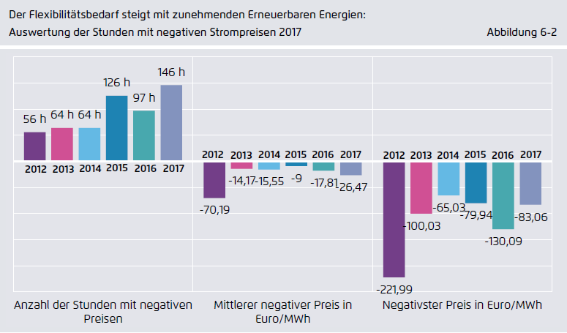
The „flexibility” need is increasing due to the increasing ratio of intermittent renewable generation (negative prices)

Slide 30
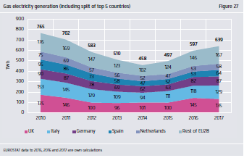
Regulating Power from flexible Gas fired units: increasing volume

Slide 31
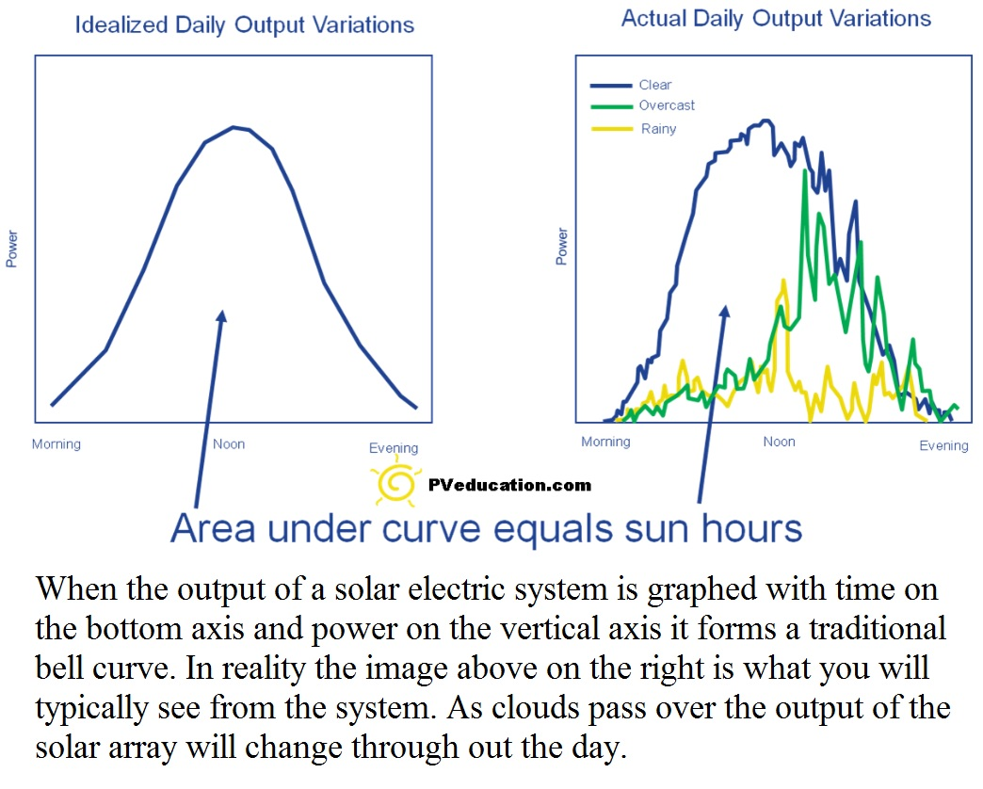
Why we need a flexible power system and network? (2)
Deviation from a planned / normal generation, especially in case of Solar Panels

Slide 32
Grid Management (Voltage regulation with PV injection on LV lines); need flexibility
Source: Deloitte Hungary - 2019

Slide 33
Demand side flexibility models

Slide 34
Why New Regulatory Attitude is Necessary?
At the same time, digitalization is enabling demand to be more flexible, allowing demand profiles to be adjusted to supply peaks in renewable. Eurelectric, which represents the common interests of the electricity industry at pan-European level, says Europe will have 120-150 GW of DSR flexibility by 2045.
In light of these fast developments, the gap is widening between technological advancements and the mechanisms designed to regulate them. In fact, ”75% of European network leaders say regulation is not moving fast enough”. There is therefore now an urgency for governments and regulators to rapidly move to a new regulatory model, striking a balance between protecting consumer interests and allowing businesses to innovate, all the while working within legacy frameworks.

Slide 35
Why New Regulatory Attitude is Necessary?
Given the pace and scale of change in the energy sector, regulation needs to be adaptive, shifting to a more responsive, iterative approach. Focus must be on outcomes and performance, not processes, and system optimization in pursuit of the most efficient, most cost-effective and fairest consequences for all market participants. And crucially it needs to be risk-based, moving away from one-sized fits all regulation to a data-driven, segmented approach.
Source: Benoit Laclau, EY Partner

Slide 36
  Innovation in Energy Industry
In order to facilitate decarbonisation, digitalisation, and decentralisation of the electricity industry along with electrification of other sectors, the power networks require significant innovation;
- not only in their technological dimensions, but also
- in aspects of their organisational and business models.
The Oxford Institute’ results of review of innovations in the electricity grid show that while both transmission and distribution networks need technological modernisation, most commercial and process innovations are needed at the level of the low-voltage grid. This is mainly because of the rapid transformation of grid edge technologies, which necessitates different modes of operation for electricity distribution networks.

Slide 37
  Innovation at the Network Companies – Potential New Regulatory Attitude (Challenge of Regulatory Incentives)
  Network companies are regulated natural monopolies; this means that they hardly ever undertake innovation activities in the absence of sufficient incentives. Traditional regulatory models of network utilities are designed to incentivise cost efficiency, with the assumption that network business is costly and the task of regulation is to lower these costs, subject to achieving a certain level of reliability. The main challenge of incentivising innovation is that it is not only costly but also risky. Therefore, an innovation-oriented regulatory model needs to factor in uncertainty in the outcome of innovation efforts.

Slide 38
  Innovation related Regulatory Issues (2)
  What could happen without regulatory support of innovation?
  If the Regulator not inform the monopolies (and new market entrants) in advance, that ready to share the innovation related risk among the investors and consumers, the consequences could lead to situation:
    the monopolies are waiting for mature technologies to implement (do not take the risk with emerging technologies and methods)
    the consumers - connected to these network companies - will benefitting the advantages of developments and new innovative services (like higher service level, more reliable service, more customer choice,…) some years later

Slide 39
Potential Regulatory Support for Innovation (3)
Government and regulators can play a role by creating “sandboxes” to accelerate innovation; sandboxes allow start-ups and other innovators to conduct live experiments in a controlled environment under a regulator's supervision.
What is the regulatory sandbox?
The regulatory sandbox allows for the trialing of innovative business products, services and business models that cannot currently operate under the existing regulations. Trials run for a set period of time with a limited number of customers.

Slide 40
Regulatory Dilemma supporting „new” technologies and innovative solutions
Should the Regulatory Authorities accept part of the cost and risk of the development (utilization) of new, innovative technologies through network tariff regulation?
  Advantage: optimized network operation and development + smart network/system could incorporate more renewable and could provide better service to end-users
  Disadvantage: network tariff increase in transition period
Should the Regulatory Authorities support market players with new, innovative technologies, like storage?
  Are the new players active enough on the wholesale and reserve markets with this capital intensive technology?
  Should the Regulators allow energy companies competing with storage technology (until the market liquidity increasing)?

Slide 41
Demand Response in the market to reduce high prices on the Power Exchange – benefit for traders and end-users

Slide 42
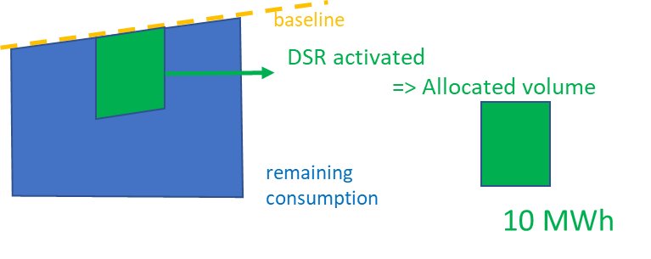
Position of DR4EU on Imbalances and on Baseline methodologies
Aggregators are held to the same level of obligation in regards of balance responsibility as other participants. This means that they are responsible for the imbalances that they create on the system.
The definition of imbalances for aggregators is the same as for other market players. It is the difference between their allocated volume and their final position in the market:
Imbalance = allocated volume - final position in the market
The final position in the market is the net of the bought and sold volumes by the aggregator (same as for any other market participants).
The allocated volume is defined as the difference between the metered volume and a baseline that calculates the consumption without Demand Response (as clarified by recital 15 of the Regulation).
There can be a number of baseline methodologies and they can co-exist together, as the aggregator is able to choose which one is relevant based on the technology and market at hand. It is important that aggregators can propose such baseline methodologies to the System Operator

Slide 43
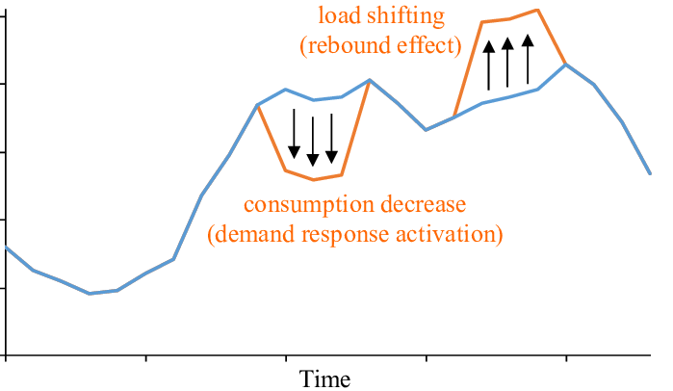
Argument of the effected traders/ suppliers on the Rebound Effect caused by the Aggregator through Demand Response Activation
Traders’ argument: More balancing activity is necessary at the supplier side due to the rebound effect

